Slide 1
Large scale monitoring networks and the challenges of accurate measurement
Daniel Rylett
11.07.24
Photo Credit: Mairi Simms

Slide 2
Monitoring Around the World: UK
Photo Credit: Phil St Quentin
Notes:
James Hutton Institutes Glensaugh Research Station

Slide 3
Monitoring Around the World: India
Notes:
University of Agricultural Sciences in Dharwad

Slide 4
Monitoring Around the World: Kenya
Notes:
Climate station on a tea plantation in Kenya

Slide 5
Monitoring Around the World: The Antarctic
Notes:
Automated Weather Station on an ice shelf in the Antarctic

Slide 6
UKCEH Monitoring Networks: COSMOS-UK
COSMOS-UK uses Cosmic Ray Neutron Sensors to measure soil moisture at field scale across the UK.
Currently 45 sites, some of which have been running for over 10 years.
Additional meteorological sensors to allow calculation of PET.
Photo Credit: Phil St Quentin

Slide 7
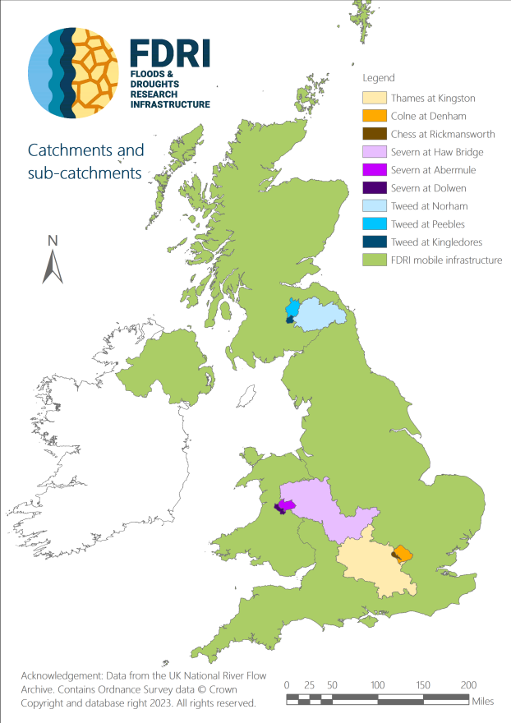
UKCEH Monitoring Networks: FDRI
The Floods and Droughts Research Infrastructure is a new project which looks to provide data to improve understanding of floods and droughts.
Looking to measure all aspects of the water balance in three sub-catchments.
Key focus on availability of data for researchers, significant investment in digital infrastructure.

Slide 8
An Alternative Approach: UK-FLUX
UK-FLUX is a collection of science projects measuring greenhouse gas fluxes across the UK.
Currently around 45 sites with eddy covariance stations.
Answering science questions around topics like carbon sequestration and reducing emissions.
Uses the same team of staff to install and maintain equipment across the projects.

Slide 9
Advantages of large-scale networks
Geographic coverage, different weather conditions, land cover, soil types etc.
Economies of scale, staff and equipment can be specifically targeted at the needs of the network.
Consistency between measurements, which improves the ability to compare between different sites.

Slide 10
Considerations for accurate measurement
Location – topography, climate, land cover, land management.
Equipment – which technology, automated or manual measurement, measurement frequency.
Calibration – Are laboratory or in-situ, generic or site-specific calibrations required.
Maintenance – Frequency and type of maintenance required, is it skilled or unskilled work.

Slide 11
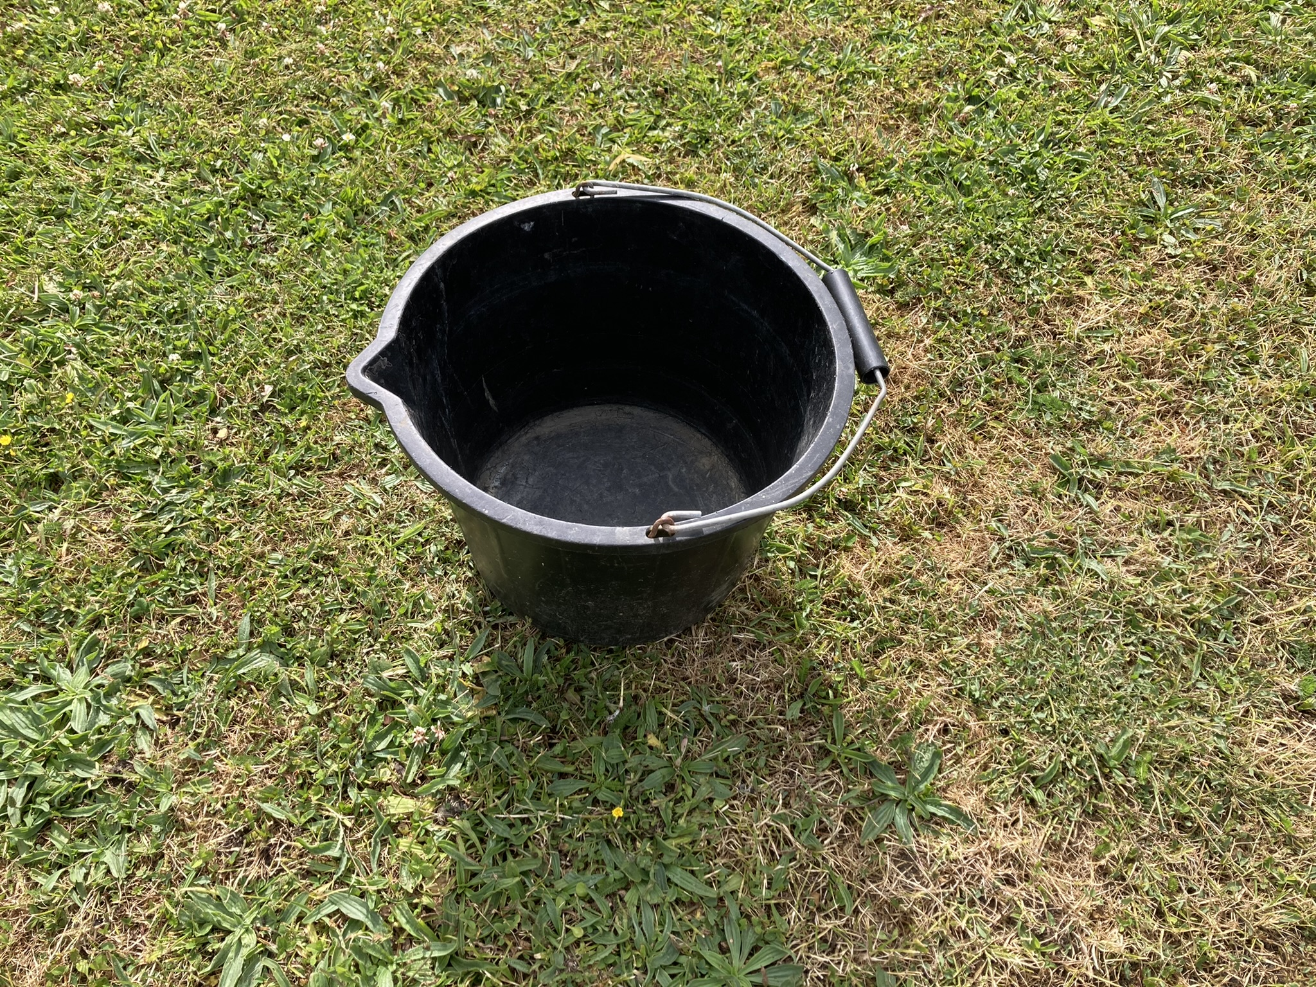
Considerations for equipment selection
What is the purpose?
What is practical?
What is in budget?

Slide 12
Storage Gauges

Slide 13
Tipping Bucket Gauges

Slide 14
Collecting Weighing Gauges

Slide 15
Weighing Tipping Bucket Gauges

Slide 16
Thank You

