Slide 1
iLEAPS: The integrated Land Ecosystem-Atmosphere Processes Study
Garry Hayman & Kirsti Ashworth
Land Surface Modelling Summit
Oxford, 14th September 2022

Slide 2
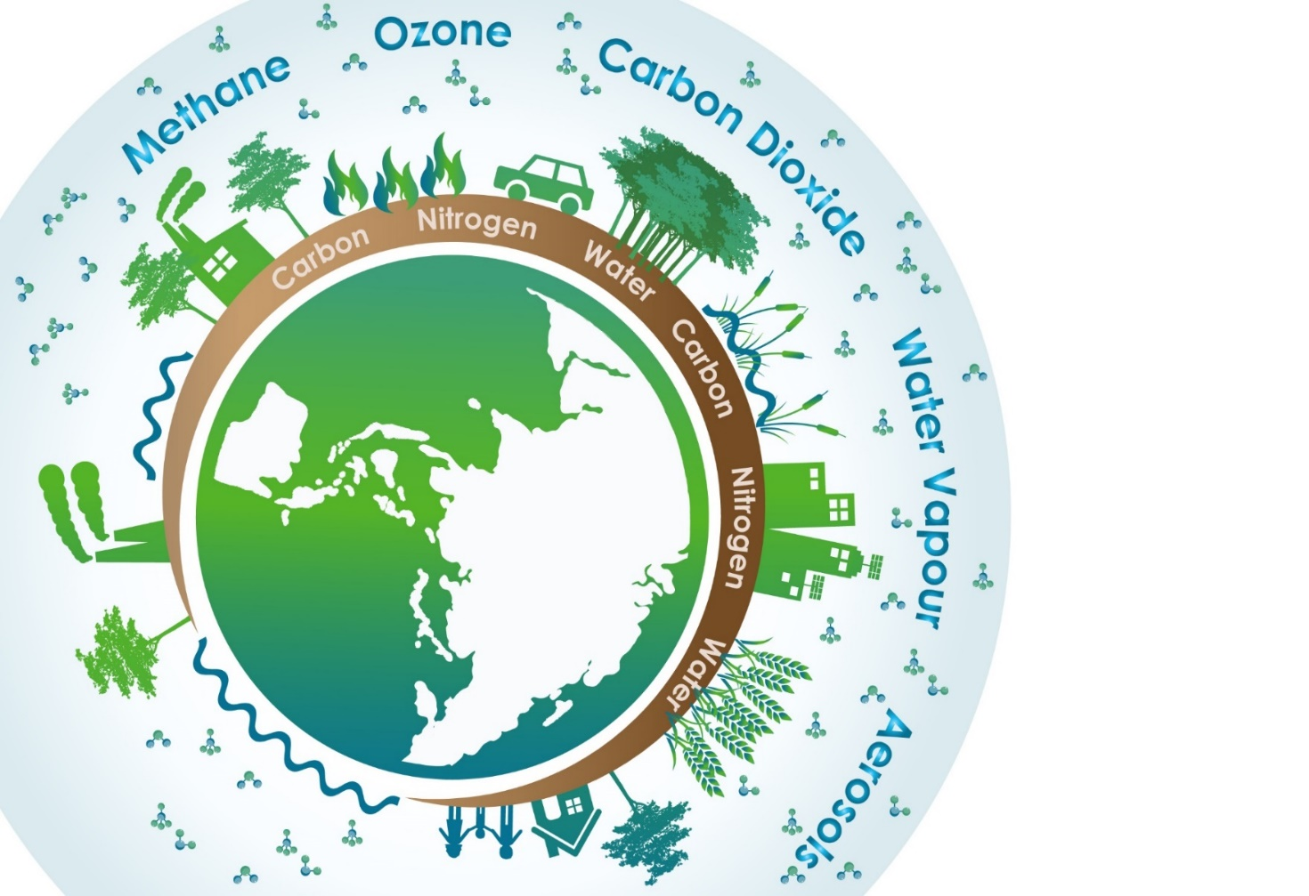
What is iLEAPS?
is a network to link iLEAPS scientists to key societal challenges related to Health, Biodiversity, Climate, Food and Fuel security
acts as a communication hub and coordinator of world-wide scientific research in the field of ecosystem-atmosphere exchanges
promotes scientific excellence through developing international science initiatives that are multi-disciplinary
promotes leadership in science through capacity building in developing countries as well as through their Early Career Scientists network

Slide 3
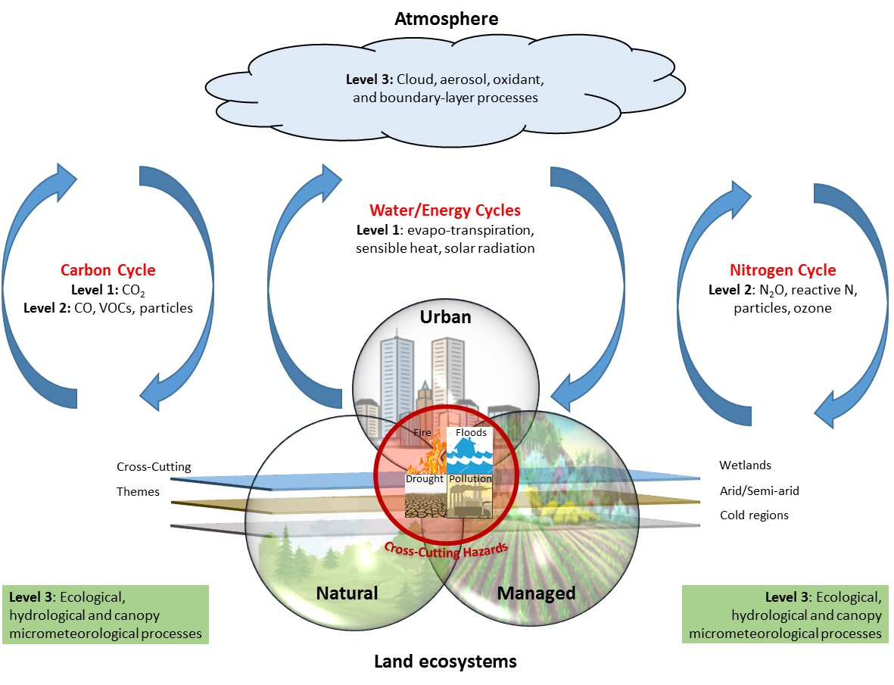
iLEAPS Research Interest
Main focal areas
Natural
Managed land
Urban
Cross-cutting themes
Cold regions
Arid/semi-arid regions
Wetlands
Fire

Slide 4
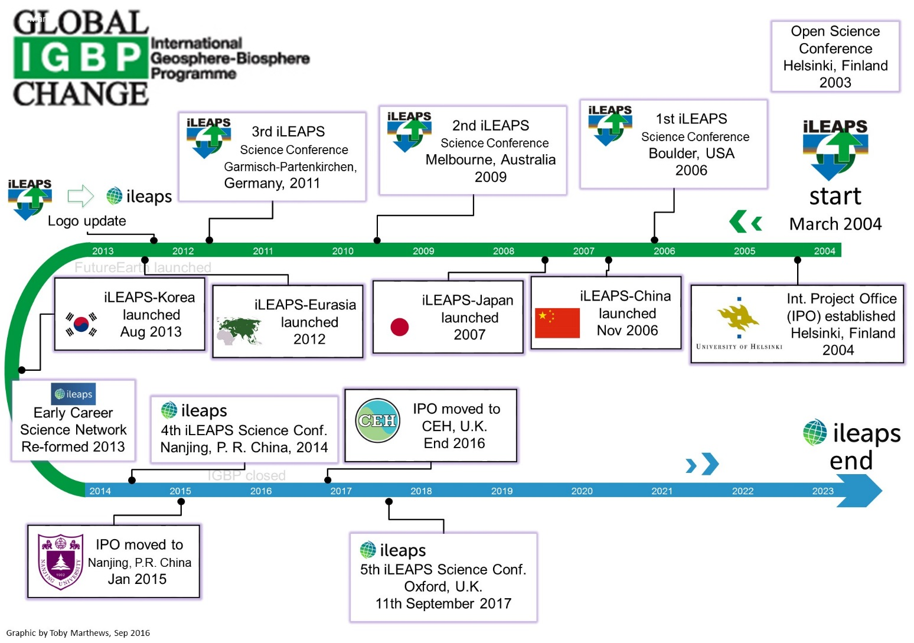
iLEAPS journey so far ….
6th iLEAPS Science Conf,, with OzFLUX
Auckland, New Zealand
February 2023

Slide 5
iLEAPS as a Future Earth Global Research Network
Surface Ocean (SOLAS)
Risk
(IRG)
Past change
(PAGES)
Earth System Modeling (AIMES)
Cities (UGEC)
WCRP
Air chemistry
(IGAC)
Land-air
(iLEAPS)
Global Land Project
iHOPE
IGBP
Diversitas
Eco
Services
Coasts
Earth system govern-
ance
IHDP
Mountain bio
diversity
Marine (IMBER)
Climate change and food security
Eco-system Change & Society
CGIAR
Eco
Health
Global Water Systems
Global Carbon Project
ICSU
Bio
Discovery
Bio
Genesis
Monsoon Asia (MAIRS)
ESSP

Slide 6
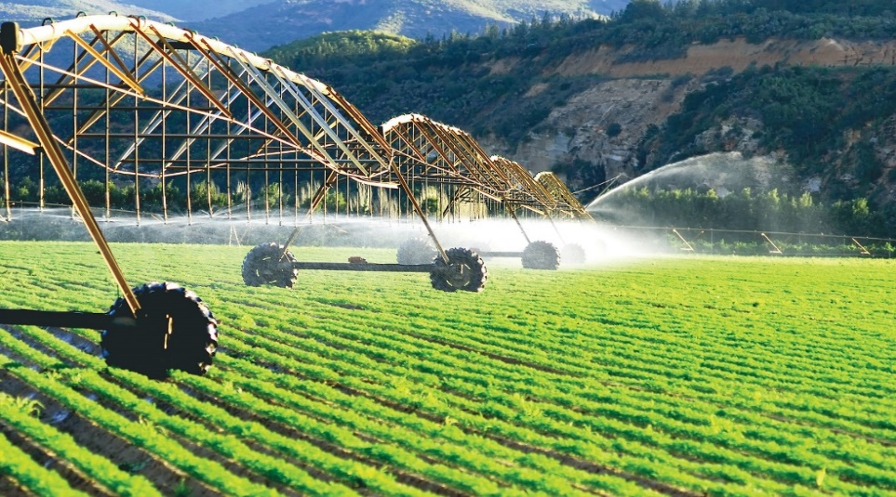
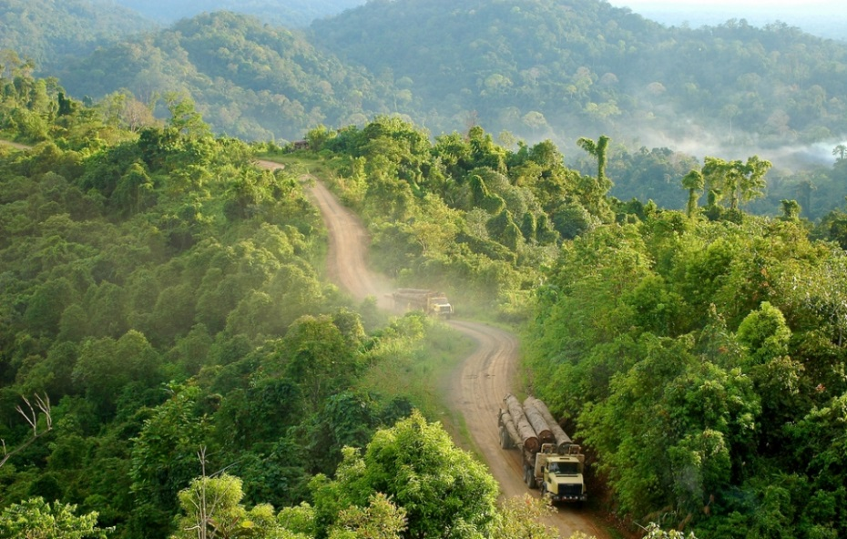
Cross-disciplinary activities
Health
Decarbonisation
Knowledge Action Networks (KANs)
Cross-disciplinary activity
Linked to UN Sustainable Development Goals
Solution oriented, co-designed & co-produced
Cities
Oceans
Finance &
Economics
*Natural assets
Sustainable
Development Goals
*Water-Energy-
Food Nexus
Transformations
*Emergent Risks
& Extreme Events
FOOD-ENERGY-WATER NEXUS
Natural Assets
Water for food: Consumption of green and blue water by agriculture; Water use for food processing
Food for energy (through land): Biomass used as domestic sources of energy; Land use for mining, for biofuel, wind and solar energy
Energy for water: Energy is essential for the development and use of water resources ranging from desalination mostly for drinking water, to groundwater pumping for domestic, industrial and irrigation uses.
Water for energy: Consumptive water use for biofuel production; Non-consumptive water use for hydropower and thermoelectric power
Energy for food: Energy inputs for food production include pumping of irrigation water, mechanization, fertilizer production, food processing, and transportation.
Understand relationships between biodiversity, ecosystems and their benefits to societies
Develop effective management and governance approaches
Mobilizing scientists, stakeholders, and policy-makers to contribute to the sustainable and fair stewardship of terrestrial, freshwater, and marine natural assets that underpin human well-being.

Slide 7
iLEAPS Scientific Steering Committee
Co-Chairs
Ben Poulter (USA) Global carbon & methane cycles
Sachin Ghude (India) Atmospheric chemistry, air quality, vegetation & human health
Members
Kirsti Ashworth (UK) Interactions between terrestrial vegetation, atmospheric composition and society
Silvano Fares (Italy) Interaction between plant ecosystems and the atmosphere.
Gregor Feig (South Africa) Air quality, biogeochemistry
Jiming Jin (China) Hydrology and lake modelling
Sirkku Juhola (Finland) Socio-economics, urban issues, adaptation of social systems
Sebastian Leuzinger (New Zealand) Global change impacts on plant communities
Xianhong Meng (China) Satellite observations data & modelling - arid & semi-arid
David Odee (Kenya) Tropical forestry & agroforestry systems
Gemma Purser (UK, ECS) Biogenic VOCs and forest ecosystems
Hisashi Sato (Japan) Mechanistic modelling of vegetation structure & function
Pallavi Saxena (India) Air pollution, impact on plants and human health, mitigation
Allison Steiner (USA) Atmospheric chemistry & land-surface processes
Stefan Wolff (Germany/Brazil) Multiphase chemistry
International Project Office: UKCEH
Garry Hayman
Semeena Shamsudheen

Slide 8
iLEAPS Early Career Scientists Network
The network is run by Early Career Scientists for Early Career Scientists engaged in iLEAPS related research.
The goal is to establish a strong community of researchers across disciplines, institutions and geographical locations by providing opportunities to meet and engage with other members of the community. This is undertaken via workshops, training events, and regional network pages.
The Early Career Scientists' Network is also a great way to connect with established scientists from iLEAPS disciplines
Role/Region
Chair | Gemma Purser
Europe & Med | Tihomir Simin
Latin America | José Morán
SE Asia & Pacific | Eliani Ezani
S.Asia & Middle East | Saurabh Sonwani
North America | Sahil Bhandari
Sub Saharan Africa | Kerneels Jars
Southern Africa | Yves Hermandez Tchiechoua

Slide 9
iLEAPS Conferences & Workshops
Conferences:
2023: 6th Open Science Conference – 31st January-3rd February, Auckland (NZ)
2017: 5th Open Science Conference, Oxford (UK)
2014: 4th Open Science Conference, Nanjing (China)
2011: 3rd Open Science Conference, Garmisch-Partenkirchen (Germany)
2009: 2nd Open Science Conference, Melbourne (Australia), joint with GEWEX
Organises workshops:
“Progress on Biosphere-Atmosphere Changes indices” (with bioDISCOVERY)
“VOC Fluxes and Chemistry”
“Land-atmosphere interactions in the urban climate”
Organises Online Events (2021 & 2022):
Lite Conferences – iLEAPS conferences with different sessions
Earth and Environmental Series - International day on Climate, Fire, Forest; Earth day; World Ozone day, Soil day, Wetland day, Environment day.
Global Colloquium Series 2022: Monthly colloquiums by invited expert speakers in the field of Earth and Environment
Joint NASA-CMS and iLEAPS workshop on remote sensing for wetland methane fluxes

Slide 10
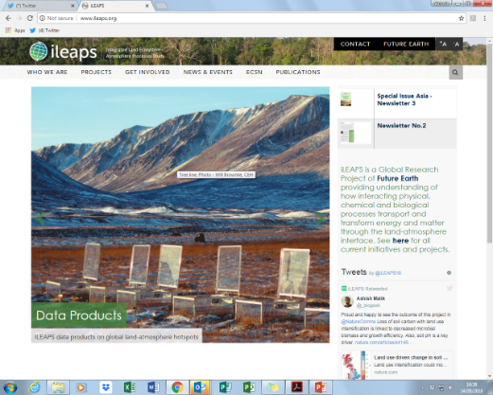
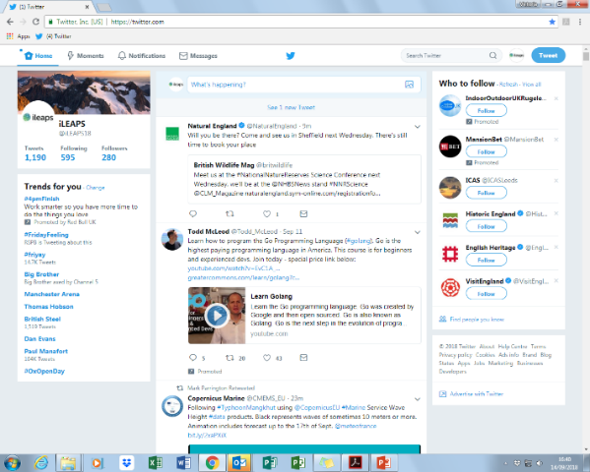
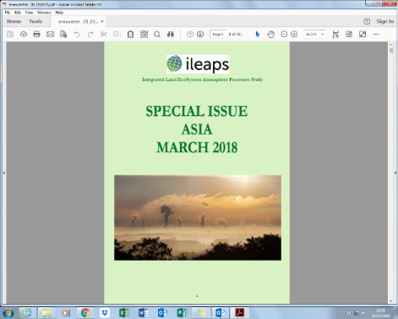
iLEAPS Communications
Website – www.ileaps.org regularly updated with news & events
Twitter - @iLEAPS18 maintained by the IPO, guest curation by SSC members
Newsletter & bulletins – communicating special interest areas as well as general iLEAPS related news and articles subscribe at www.ileaps.org

Slide 11
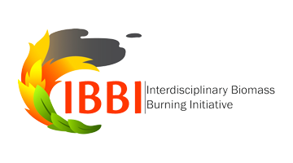
iLEAPS External Collaborations
Joint with IGAC (Global Atmospheric Chemistry)
GEIA: Global Emissions InitiAtive (http://www.geiacenter.org/)
IBBI: Interdisciplinary Biomass Burning Initiative (http://www.igacproject.org/activities/IBBI)
ACPC: Aerosols, Clouds, Precipitation and Climate, also with GEWEX (http://www.igacproject.org/activities/ACPC)
Other
E3S: Extreme Events and Environments from climate to Society (http://www.e3s-future-earth.eu/index.php/Main/Home), with Future Earth, WCRP, GEWEX, IHDP, PAGES, ….
=> Reducing Disaster Risks under Environmental Change KAN/GRN
iLAMB: integrated Land Atmosphere Model Benchmarking system, with GEWEX

Slide 12
iLEAPS-AIMES-GEWEX
iLEAPS-GEWEX
Long standing relationship
iLEAPS representation on GLASS panel
Previously held joint conferences/conference sessions
Initial discussions held on carbon cycles, especially fluxes
iLEAPS-AIMES
Fire session (with IGAC) at the Future
Possible activities: host/organise/facilitate
Webinars
Workshops
Working groups

