Slide 1


GEWEX Science Priorities
GEWEX Science Plan 2023-2032
Addressing the challenges in understanding and predicting changes to water availability in the coming decades
An Earth Observation Perspective

Slide 2

https://www.gewex.org/about/science/gewex-science-goals/
https://www.gewex.org/gewex-content/uploads/2022/05/GEWEX-science-plan-v8.pdf

Slide 3
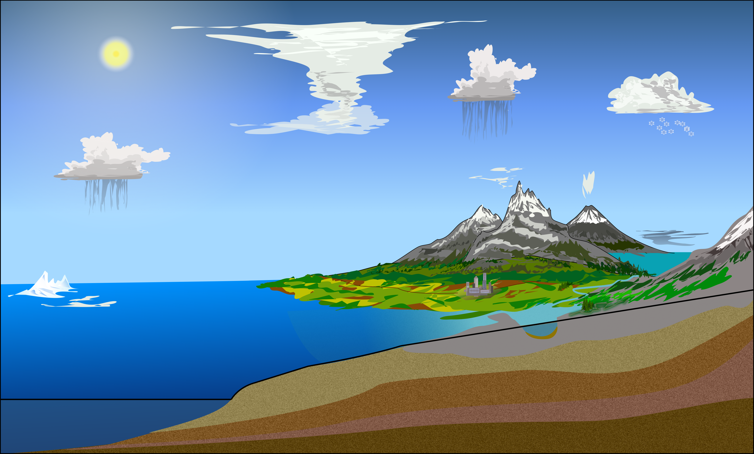


© Peter van Oevelen, 2020
GEWEX Data Analysis Panel Global Datasets Analysis and Assessments
Global Atmospheric System Studies Atmospheric Processes - Dynamics
Global Land–Atmosphere System Studies Land-Atmosphere Interactions and Processes
GEWEX Hydroclimatology Panel Regional Focused Processes and Hydroclimate Projects
The GEWEX Panels:

Slide 4
GEWEX Science Goals

Slide 5
Goal # 1: Determine the extent to which Earth’s water cycle can be predicted
Reservoirs: What is the rate of expansion of the fast reservoirs (atmosphere and land surfaces), what is its spatial character, what factors determine this and to what extent are these changes predictable?
Flux exchanges: To what extent are the fluxes of water between Earth’s main reservoirs changing and can these changes be predicted and if so on what time/space scale?
Precipitation Extremes: How will local rainfall and its extremes change under climate change across the regions of the world?

Slide 6
Goal # 2 (GS2): Quantify the inter-relationships between Earth’s energy, water and carbon cycles to advance our understanding of the system and our ability to predict it across scales
Forcing-feedback understanding: How can we improve the understanding of climate forcings and feedbacks formed by energy, water and carbon exchanges?
ABL process representation: To what extent are the properties of the atmospheric boundary layer (ABL) defined by sensible and latent energy and water exchanges at the Earth’s surface versus within the atmosphere (i.e., horizontal advection and ABL-free atmosphere exchanges)?
Understanding Circulation controls: To what extent are exchanges between water, energy and carbon determined by the large-scale circulations of the atmosphere and oceans?
Land-atmosphere interactions: How can we improve the understanding of the role of land surface-atmospheric interactions in the water, energy and carbon budgets across spatiotemporal scales?

Slide 7

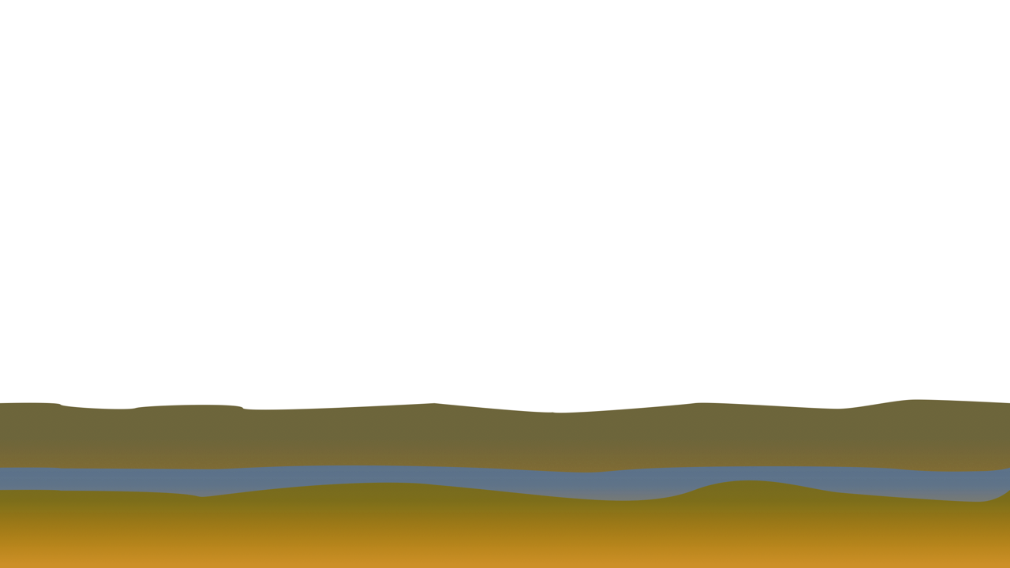

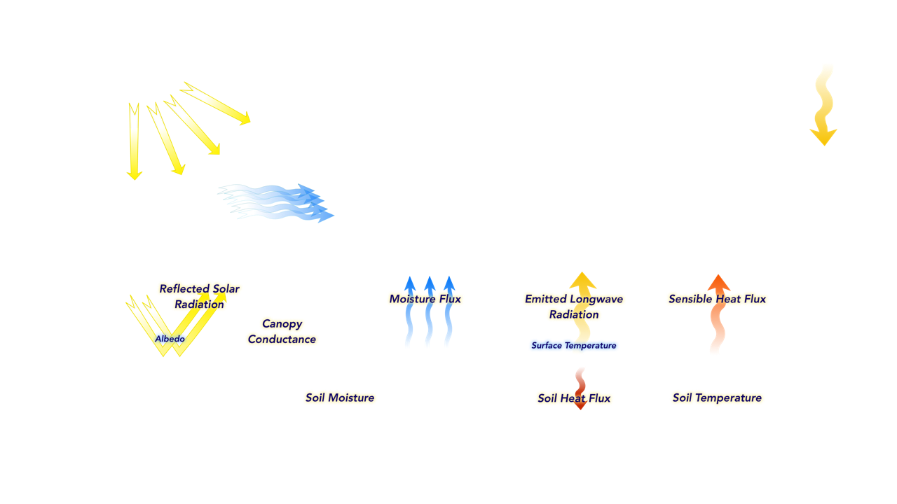
Local Land-Atmosphere Interactions – All Processes
After: Ek and Mahrt, 1994
Ek and Holtslag, 2004
Notes:
Again just as illustration the plethora of variables and their interactions when dealing with process studies. Some are more or less directly observable (incoming solar, surface albedo,..) but many are not (entrainment, turbulence,…).

Slide 8
Goal # 3 (GS3): Quantify anthropogenic influences on the water cycle and our ability to understand and predict changes to Earth’s water cycle.
Anthropogenic forcing of continental scale water availability: To what extent has the changing greenhouse effect modified the water cycle over different regions and continents?
Water management influences: To what extent do water management practices and land use change (e.g., deforestation) modify the water cycle on regional to global scales?
Variability and trends of water availability: How do water & land use and climate change affect the variability (including extremes) of the regional and continental water cycle?

Slide 9




Global Land-Atmosphere System Studies (GLASS) Panel
Global Energy and Water Cycle Exchanges Project
Anne Verhoef and Kirsten Findell, GLASS co-chairs
With materials from the GLASS Panel Project Leaders and members
LSM summit
Oxford, September, 2022

Slide 10
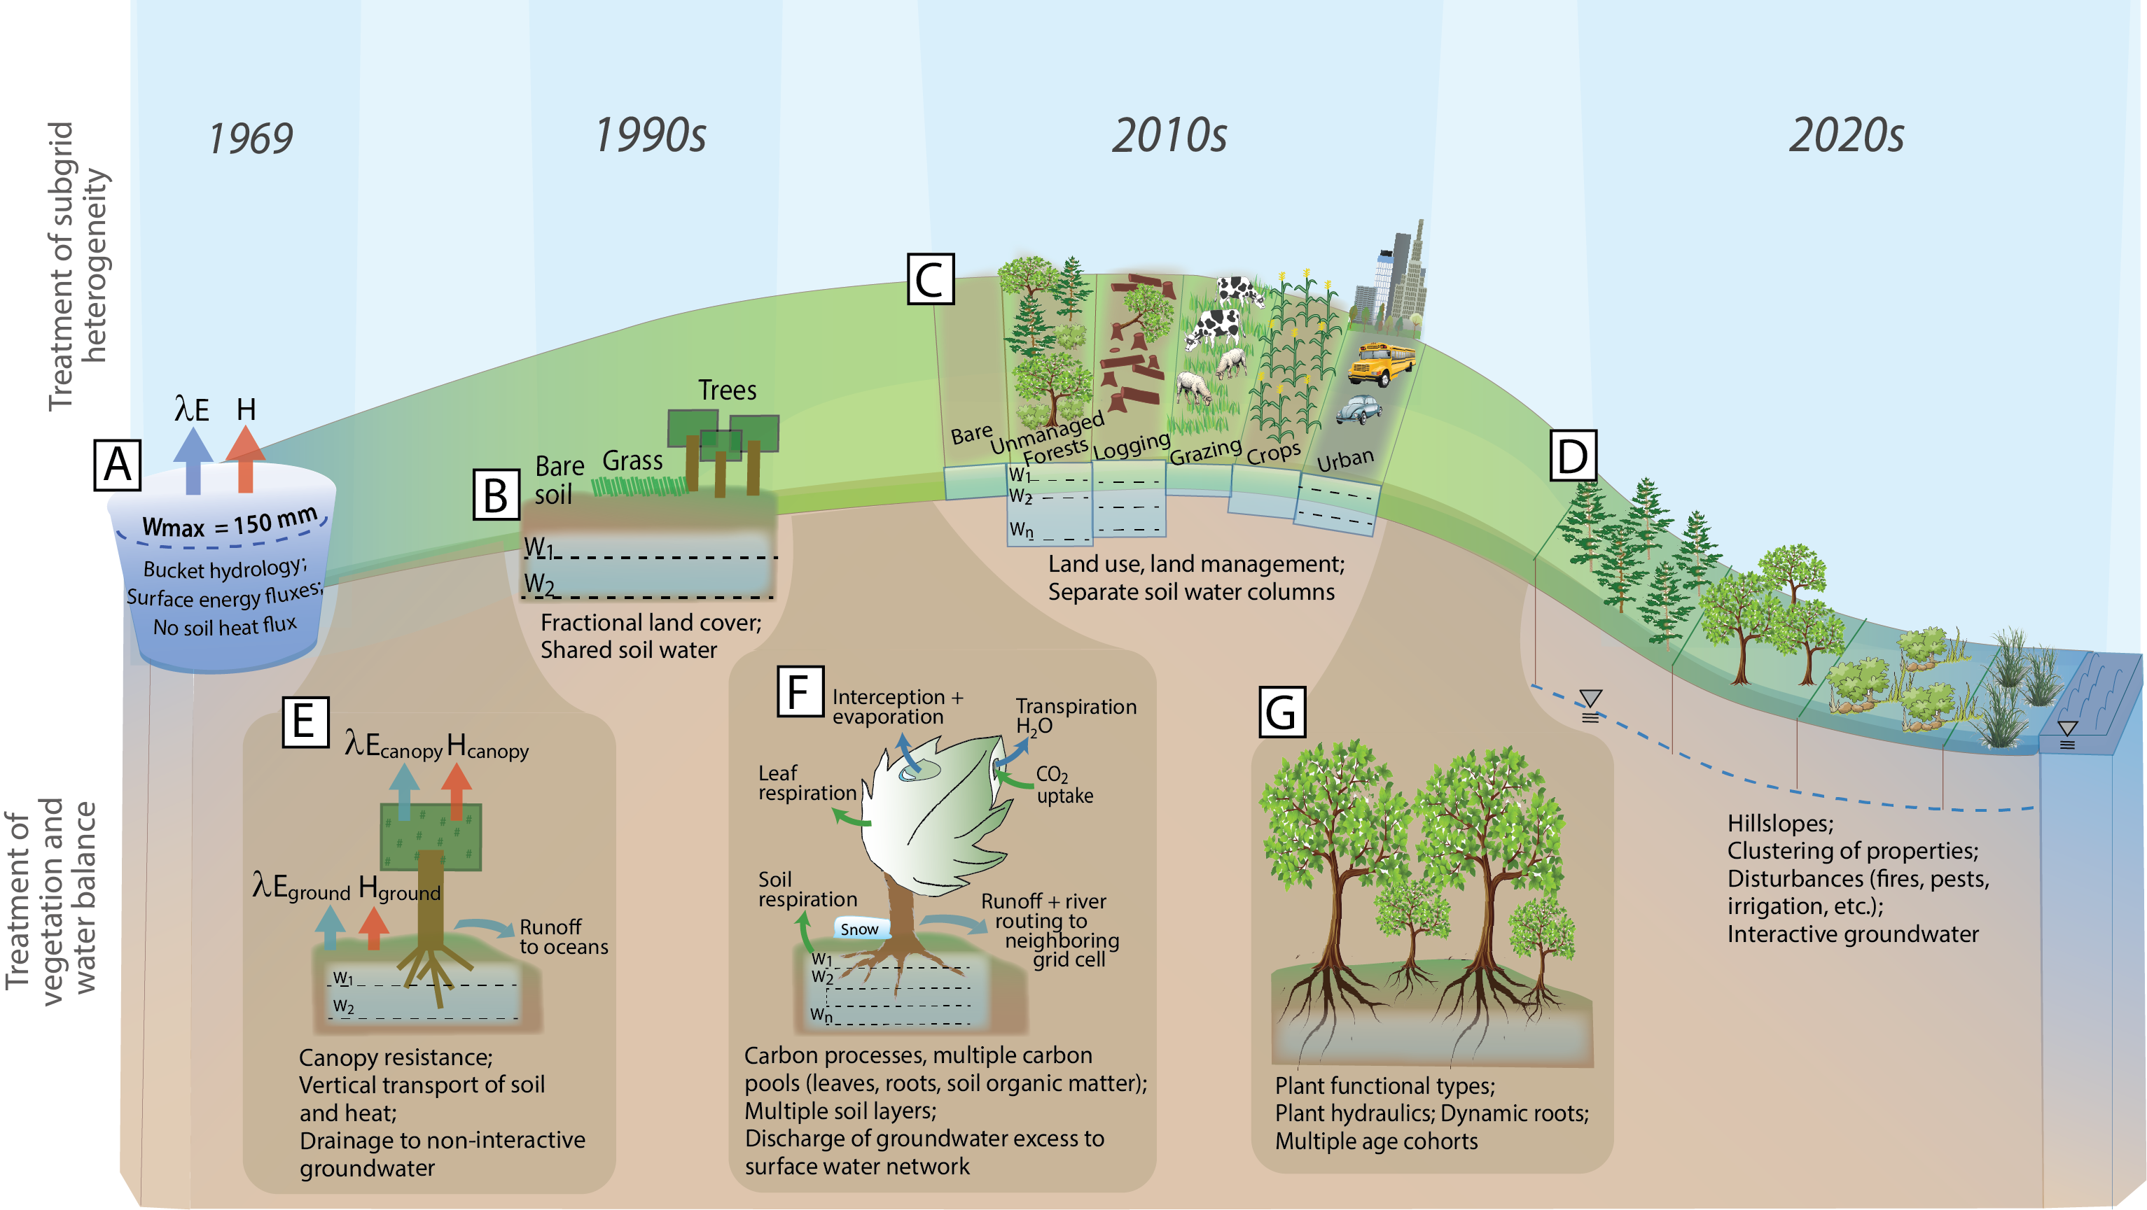
Evolution of land model formulations
Figure B1: The evolution of land model formulation in global climate and earth system models, beginning with the Manabe bucket model in 1969 (A), gradually improving the treatment of water, heat and vegetation, while also including increasingly complex and heterogeneous representations of vegetation and soil processes both above and below the land surface. Dates are approximate. Blue arrows: E = evaporative flux. Red arrows: H = sensible heat flux. Green arrows: carbon fluxes.
LSM summit, Oxford, 12-15 September 2022
LSM summit, Oxford, 12-15 September 2022

Slide 11

Ten GLASS Panel Projects:
From column (process) to global scale
LoCo: Local Coupling Working Group
GLAFO: GEWEX/GLASS Land-Atmosphere Feedback Observatories
SIFMIP: Solar-Induced Fluorescence MIP
CLASP (Coupling of Atmospheric Land and Sub-grid Parameterizations)
SoilWat: Soils and Subsurface processes
PLUMBER2: The Protocol for the Analysis of Land Surface Models (PALS) Land Surface Model Benchmarking Evaluation Project, phase 2
ILAMB: International LAnd Model Benchmarking
Modelevaluation.org: web application for evaluating and benchmarking computational models.
GSWP3: Global Soil Wetness Project, phase 3
LS3MIP: Land Surface, Snow and Soil Moisture MIP
LSM summit, Oxford, 12-15 September 2022

Slide 12
GLASS: looking ahead
Synergies between projects/panels that allow us to address current model limitations, to improve our understanding and model capability
Model systems to take in multiple RS data: Models process representation for data assimilation and with a focus on observables: SIF (SIF-MIP), VOD, optical spectra, brightness temperature, LST, etc. Links with GDAP
Representation of heterogeneity: Can the models reproduce the observations at the km scale? And at the diurnal scale? We need to replace the Monin-Obukhov theory with more suitable theory to make progress. Links with GASS, ET CC
Ecosystem process representation: 3-D connections between groundwater, soil water, roots, vegetation and atmosphere (water, heat and CO₂). Links with GHP, ET and irrigation CC
Surface water with an emphasis on lakes and reservoirs: important for land surface heterogeneity, organisation of convection, links to ET and irrigation CC, RHPs, km-scale theme, NASA SWOT satellite launch
LSM summit, Oxford, 12-15 September 2022

Slide 13
Potential emerging Activities
Groundwater/Ecohydrology: focus on watershed scale, GRACE satellite, SIFMIP/SoilWat/CLASP/GLAFO/ILAMB (metrics), ET cross-cut, links with GDAP/GHP, regional scale stores and fluxes theme
‘soil-cloud cascades’: Collaboration between CLASP, SoilWat, (GLAFO) & GDAP, GASS, km-scale & mesoscale organisation of convection themes
Connect with new GABLS (GEWEX Atmospheric Boundary-Layer Study): strong links with GASS
  Isolating components of the hydrological cycle (a period when vegetation is senescent; winter/spring period with saturated ground)
  Important to be aware of parallel/complementary initiatives like LIAISE
Make best use of existing observatories/observations through joint project consolidation efforts: Southern Great Plains, GLAFOs, LIAISE, Tibetan plateau (ground-based and RS (GDAP, GHP)
LSM summit, Oxford, 12-15 September 2022
Notes:
CDR modelling exercise, tipping points with RS data?
Future Earth ESA 18.000 Euros

