Slide 1
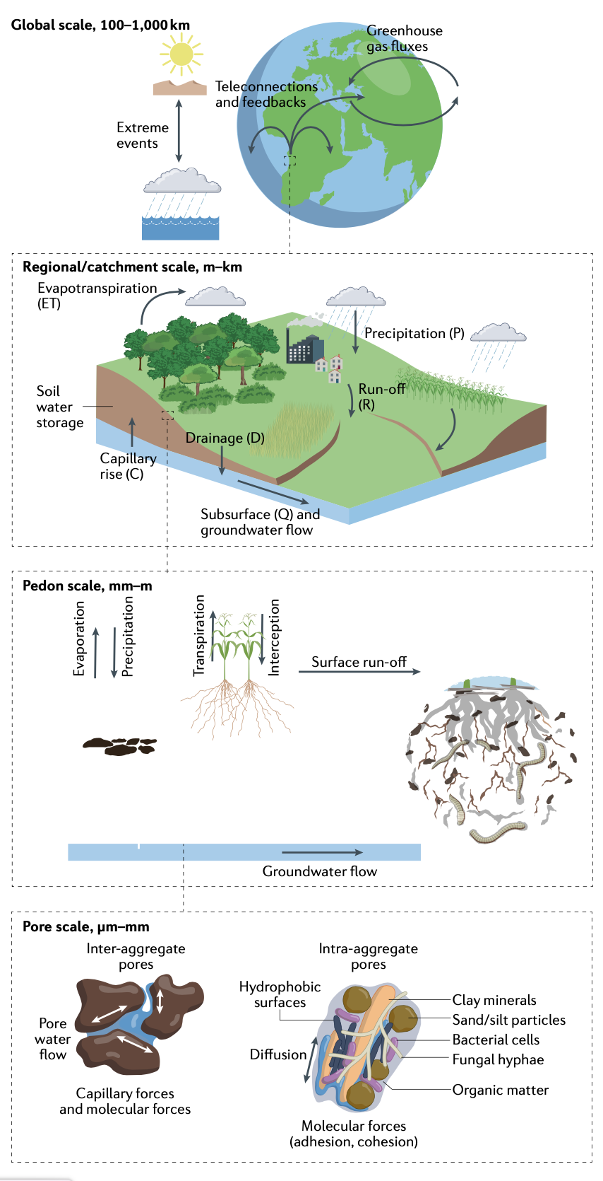
Soil-related input parameters
https://doi.org/10.1038/s43017-022-00324-6
Anne Verhoef, GLASS co-chair With materials from the GLASS SoilWAt project, and ISMC members
LSM summit meeting, Oxford, September, 2022

Slide 2
Soil input parameters; current situation
Main parameters:
soil hydraulic parameters (water retention curve and hydraulic conductivity curve)
soil thermal properties (thermal conductivity and heat capacity)
soil biogeochemical parameters
vegetation-related (root depth)
General: soil profile depth, soil layer thickness
Soil maps & related datasets : basic soil properties; semi-realistic vertical distribution
Classic soil PedoTransfer Functions (PTFs) or GeoTransfer Function (CoGTF) Frameworks
Choice of soil dataset, soil covariates
Choice of PTFs or CoGTF, and type and source of environmental covariates
LSM summit, Oxford, 12-15 September 2022

Slide 3
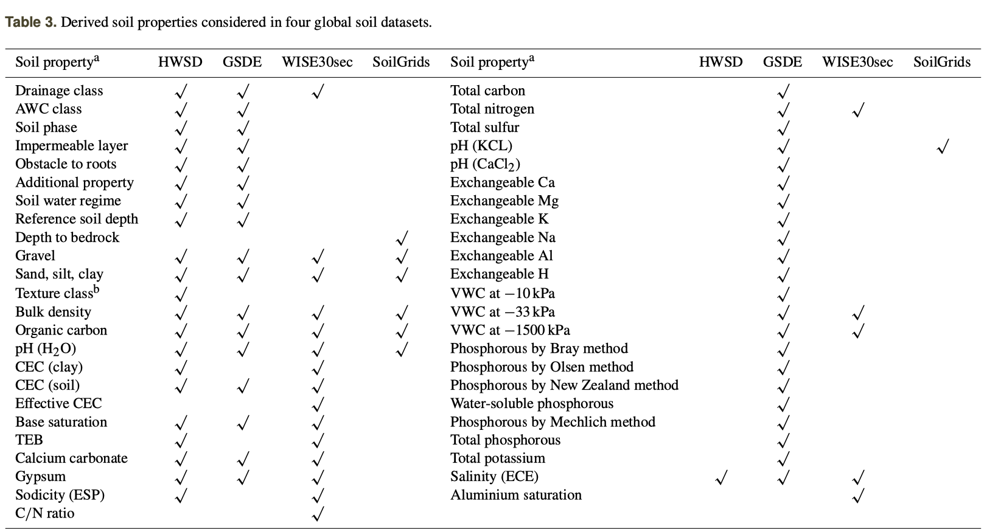
Derived soil properties in global datasets
Dai et al., 2019.: A review of the global soil property maps for Earth system models, SOIL, 5, 137–158, https://doi.org/10.5194/soil-5-137-2019, 2019
LSM summit, Oxford, 12-15 September 2022

Slide 4
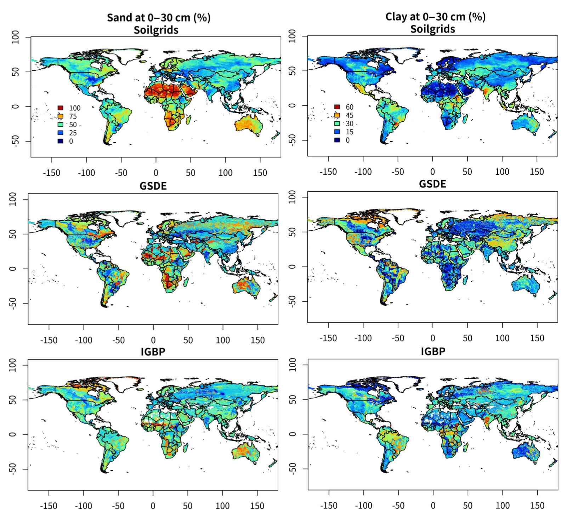
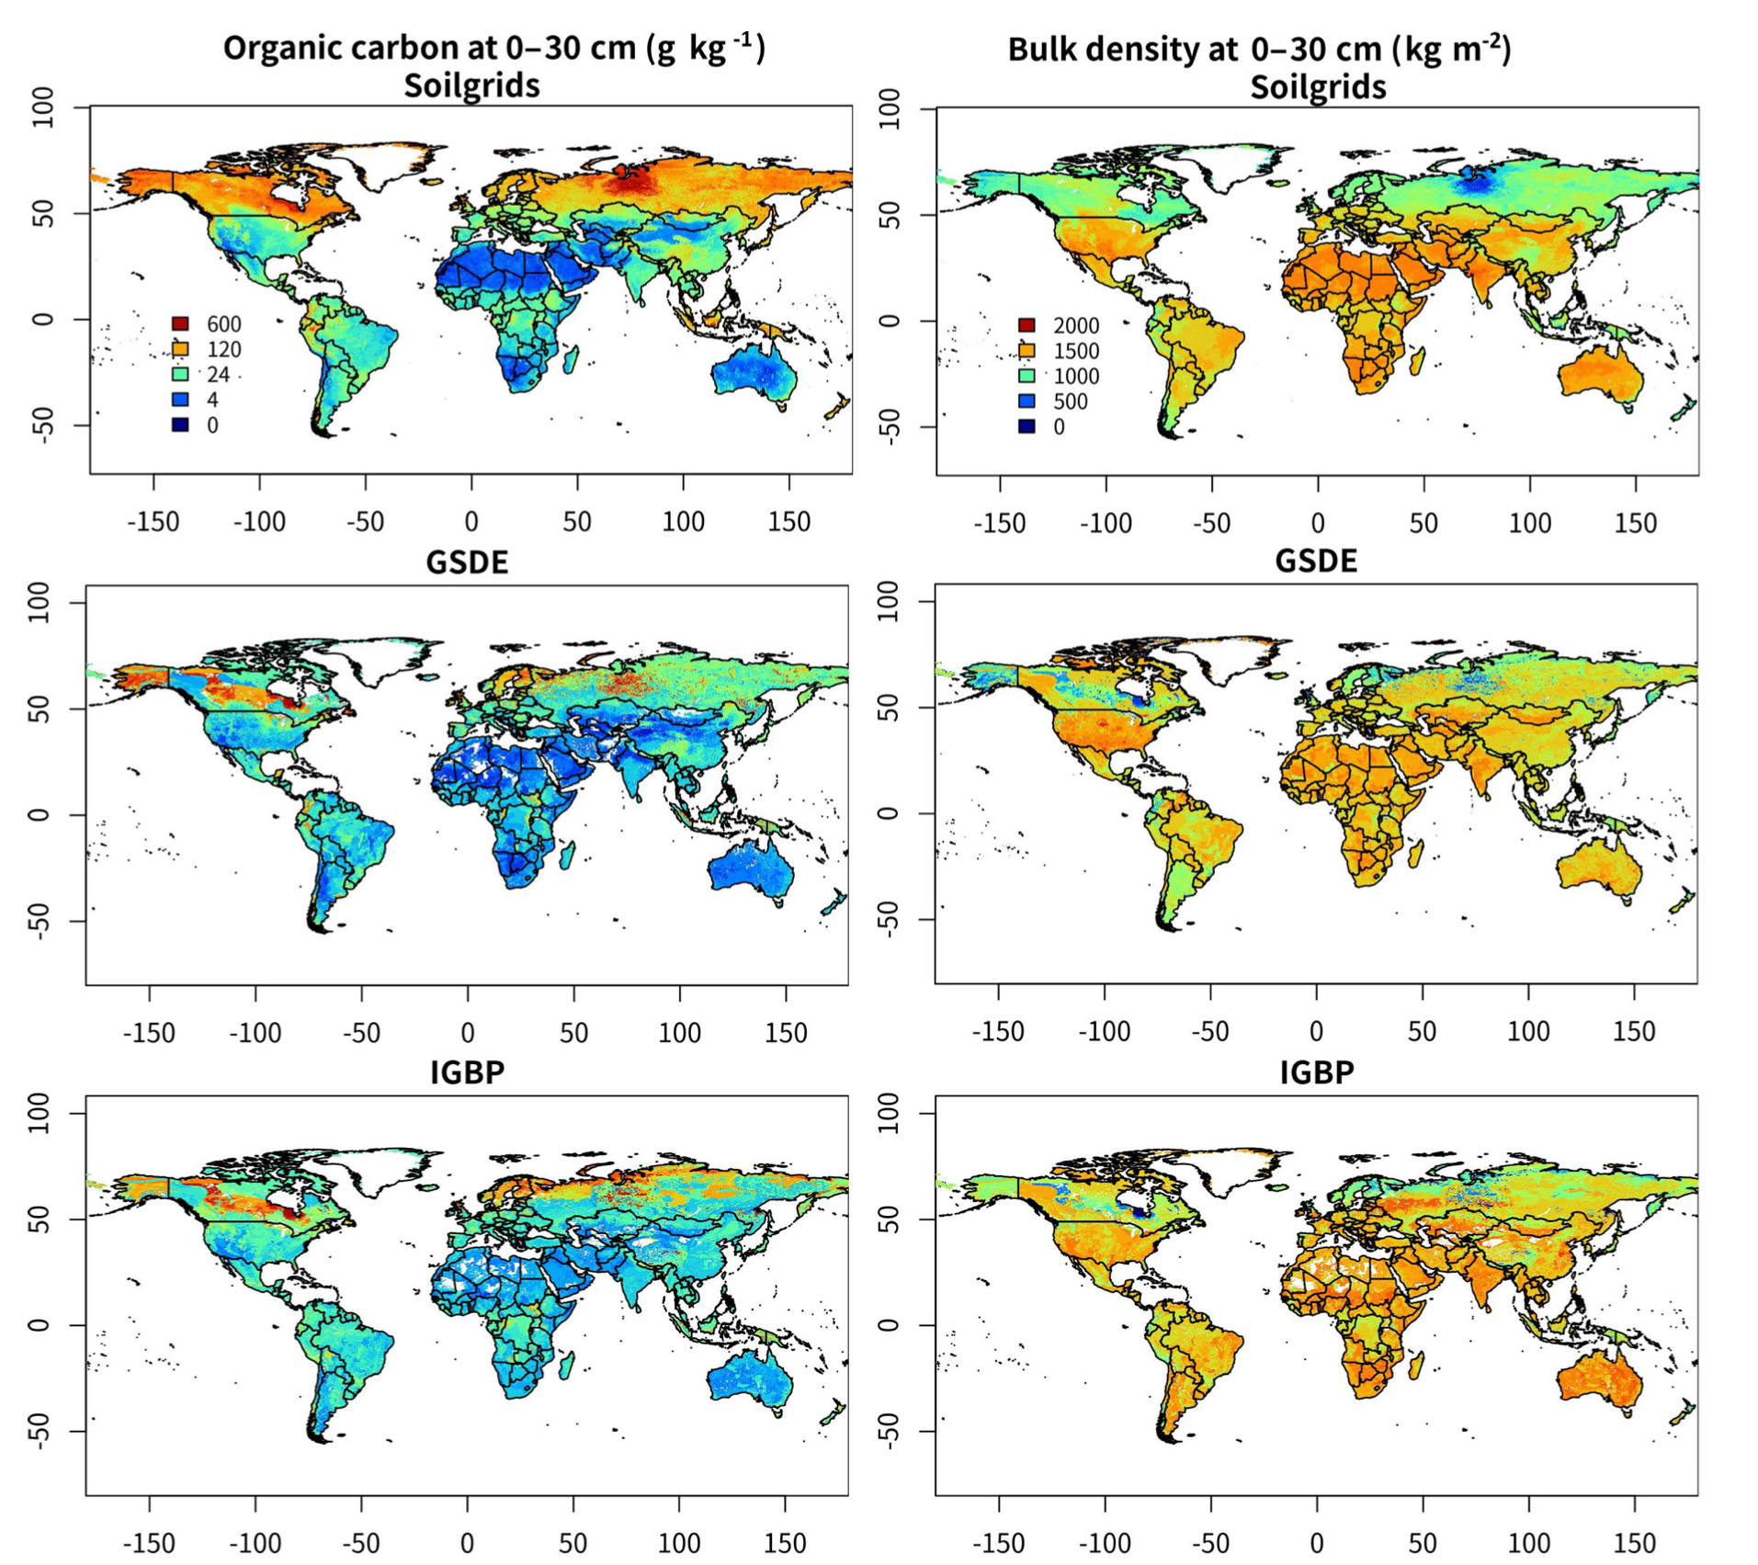
Global soil datasets
Dai et al., 2019.: A review of the global soil property maps for Earth system models, SOIL, 5, 137–158, https://doi.org/10.5194/soil-5-137-2019, 2019
LSM summit, Oxford, 12-15 September 2022
Notes:
Global Soil Dataset for Earth System Models (GSDE) and SoilGrids soil composition databases.

Slide 5
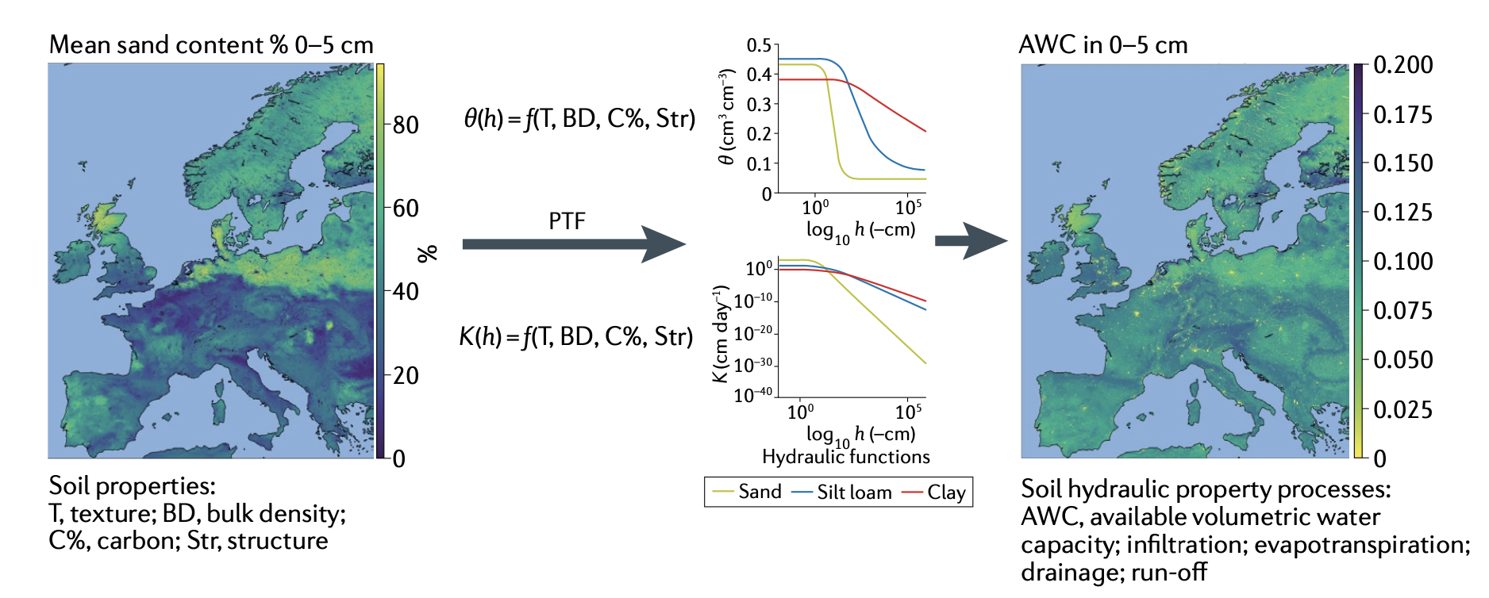
Classical pedotransfer function (PTF) approach
Vereecken, H., Amelung, W., Bauke, S.L. et al. Soil hydrology in the Earth system. Nat Rev Earth Environ 3, 573–587 (2022). https://doi.org/10.1038/s43017-022-00324-6
LSM summit, Oxford, 12-15 September 2022

Slide 6
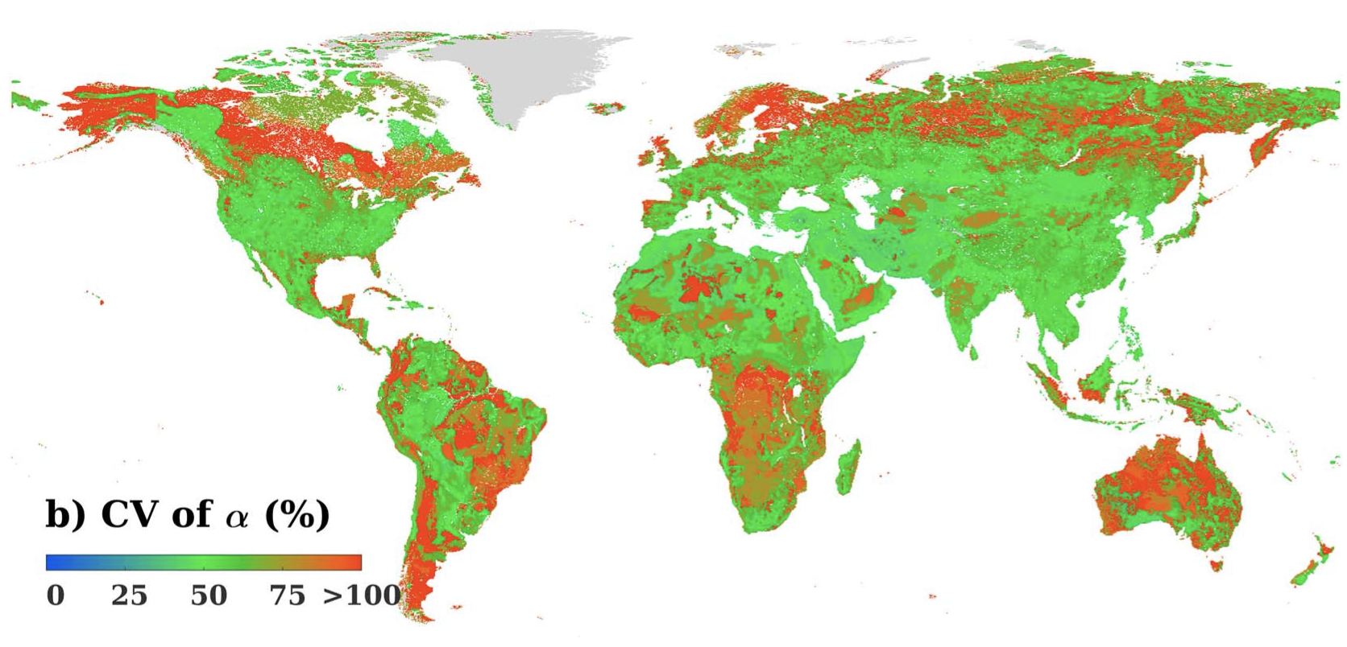
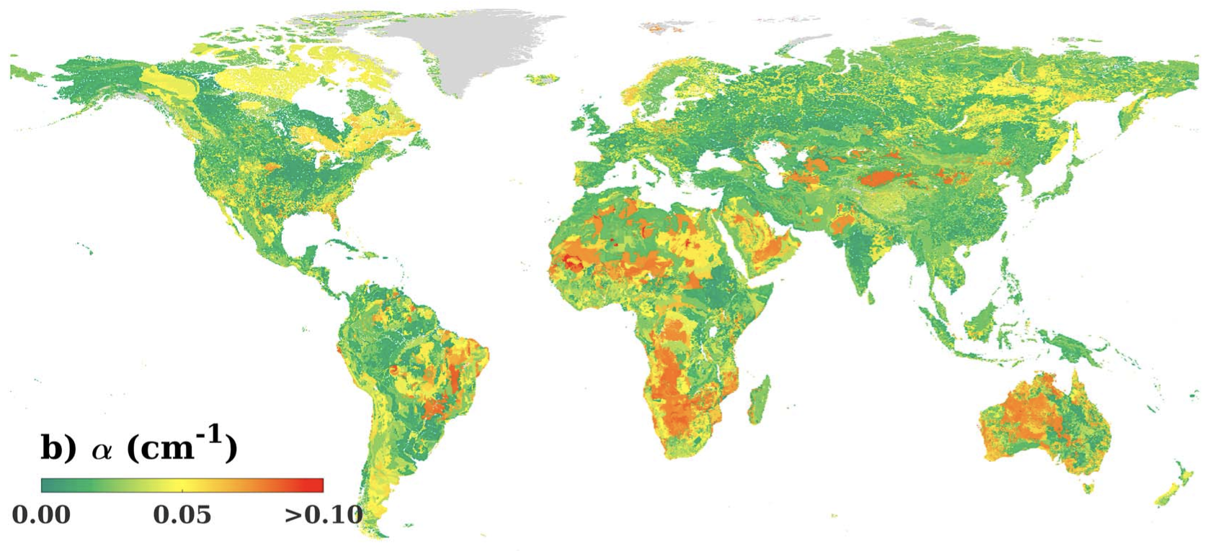
Soil hydraulic and thermal properties datasets
Dai, Y. J. et al. A global high-resolution data set of soil hydraulic and thermal properties for land surface modeling. J. Adv. Model. Earth Syst. 11, 2996–3023 (2019).
LSM summit, Oxford, 12-15 September 2022
Notes:
Examples of VG parameters obtained with ensemble PTFs, with CV. Soil hydraulic conductivities are still estimated as the median values of multiple PTFs,
Global maps derived based on the Global Soil Dataset for Earth System Models data set for (a) logarithmic saturated soil hydraulic conductivity (log10Ks, cm/day) and (b) saturated soil water content (θs, cm3 cm‐3). Data are shown for the second soil layer with the depth from 0.05 to 0.15 m.
The same as Figure 4 but for coefficients of variation (CVs) of logarithmic saturated soil hydraulic conductivity among multiple pedotransfer functions.

Slide 7
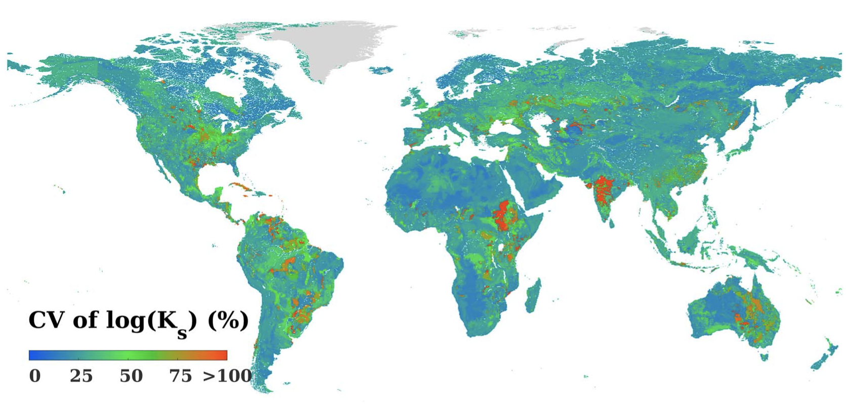
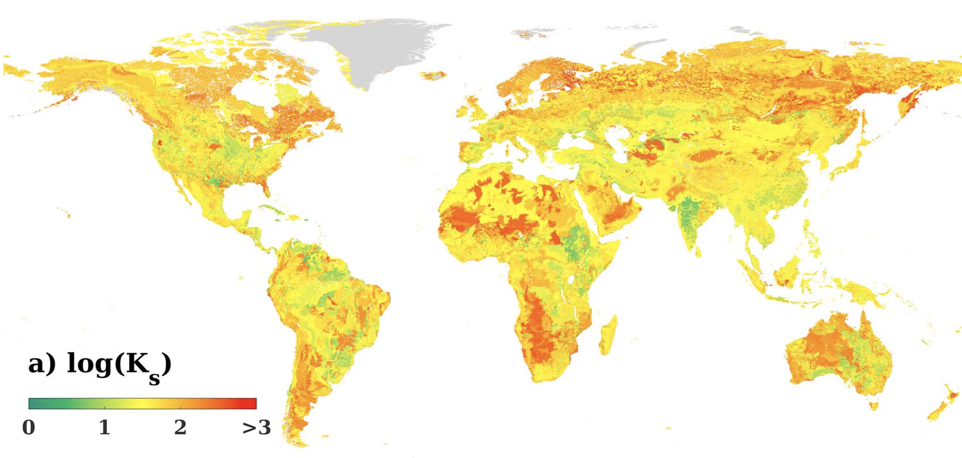
Soil hydraulic and thermal properties datasets
Dai, Y. J. et al. A global high-resolution data set of soil hydraulic and thermal properties for land surface modeling. J. Adv. Model. Earth Syst. 11, 2996–3023 (2019).
LSM summit, Oxford, 12-15 September 2022
Notes:
Examples of VG parameters obtained with ensemble PTFs, with CV

Slide 8
GeoTransfer Function (CoGTF) Frameworks
includes effects of soil, terrain, climate, and vegetation
harness technological advances in machine learning and availability of remotely sensed surrogate information
a global compilation of 6,814 geo-referenced K_{sat} measurements from the literature was used, larger than those previously used by Zhang and Schaap (2017) and Dai et al. (2019)
The generated maps of K_{sat} at 1 km resolution represent spatial patterns of soil formation processes more distinctly than previous global maps of K_{sat} based on easy-to-measure soil properties.
Gupta et al. (2021). Global prediction of soil saturated hydraulic conductivity using random forest in a Covariate-based GeoTransfer Function (CoGTF) framework. Journal of Advances in Modeling Earth Systems, 13
LSM summit, Oxford, 12-15 September 2022

Slide 9
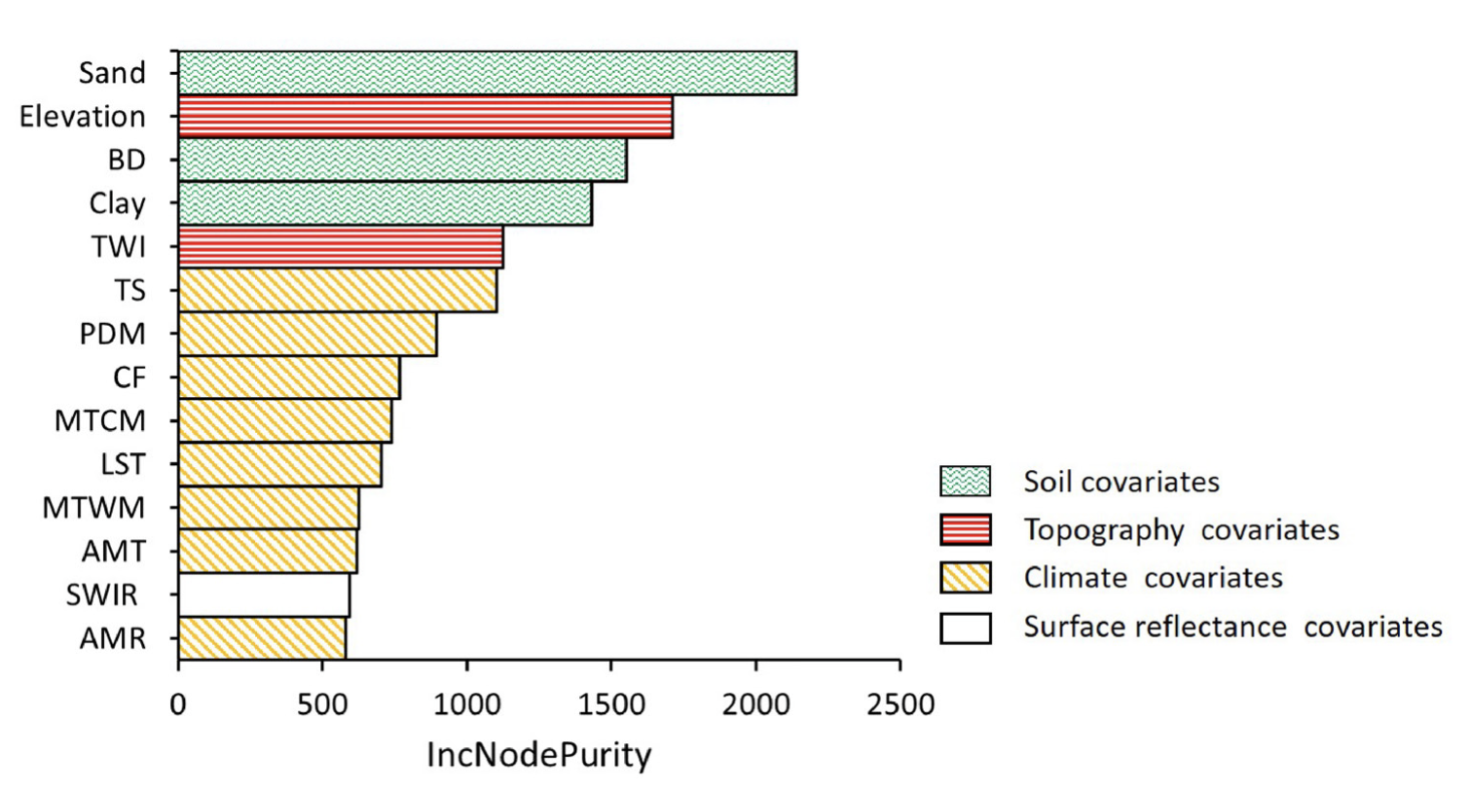
GeoTransfer Function (CoGTF) Frameworks
Relative importance of different covariates
Bulk density
Topographic wetness index
Temperature seasonality
Precipitation of the driest month
LSM summit, Oxford, 12-15 September 2022
Gupta et al. (2021).

Slide 10
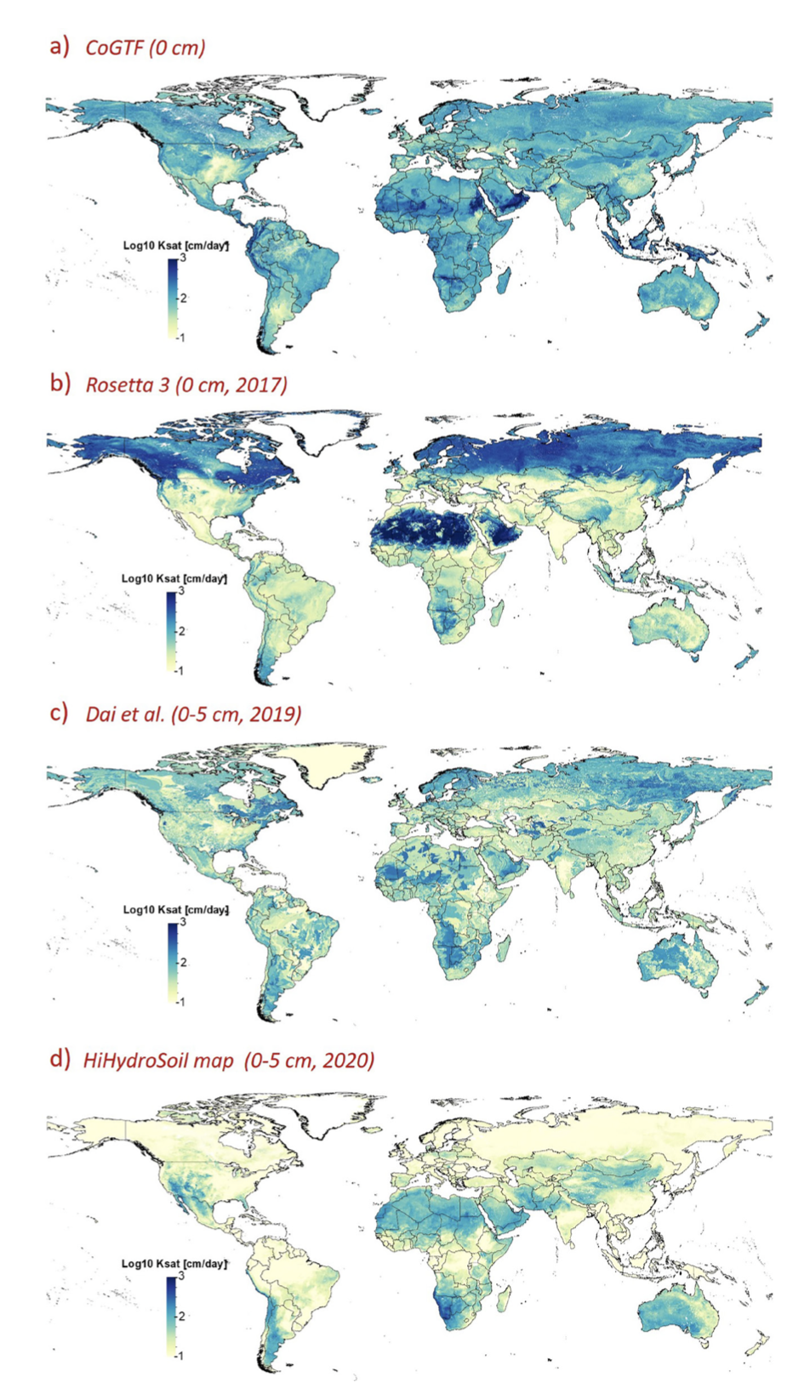
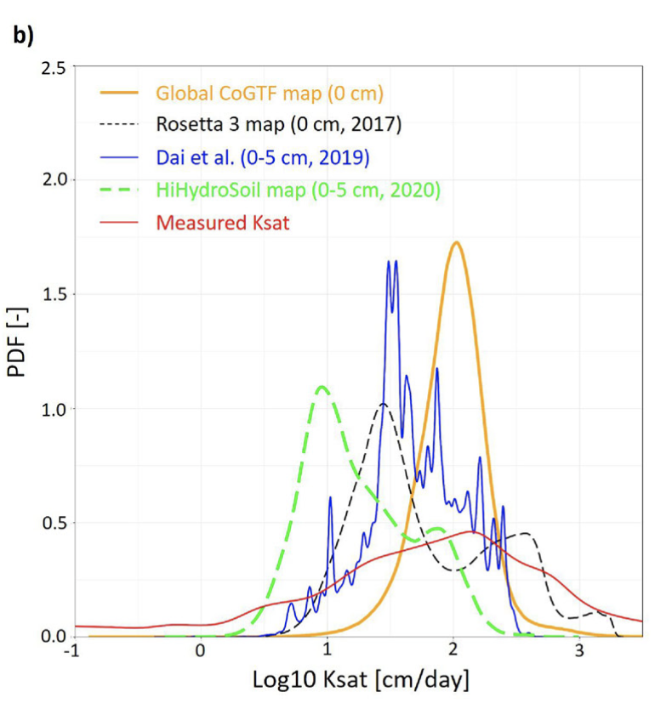
Gupta et al. (2021).
LSM summit, Oxford, 12-15 September 2022

Slide 11
Soil input parameters; improvements needed
soil profile depths, realistic maximum root-depth and root distribution
Influence of clay type (well-weathered tropical clays versus younger temperate clays)
Influence of stones on hydraulic (and thermal) properties
Swelling and shrinking in soils
Soils with macro-porosity requiring bi- or multi-modal hydraulic properties
Soil-root hydraulic interactions and root water uptake
LSM summit, Oxford, 12-15 September 2022

Slide 12
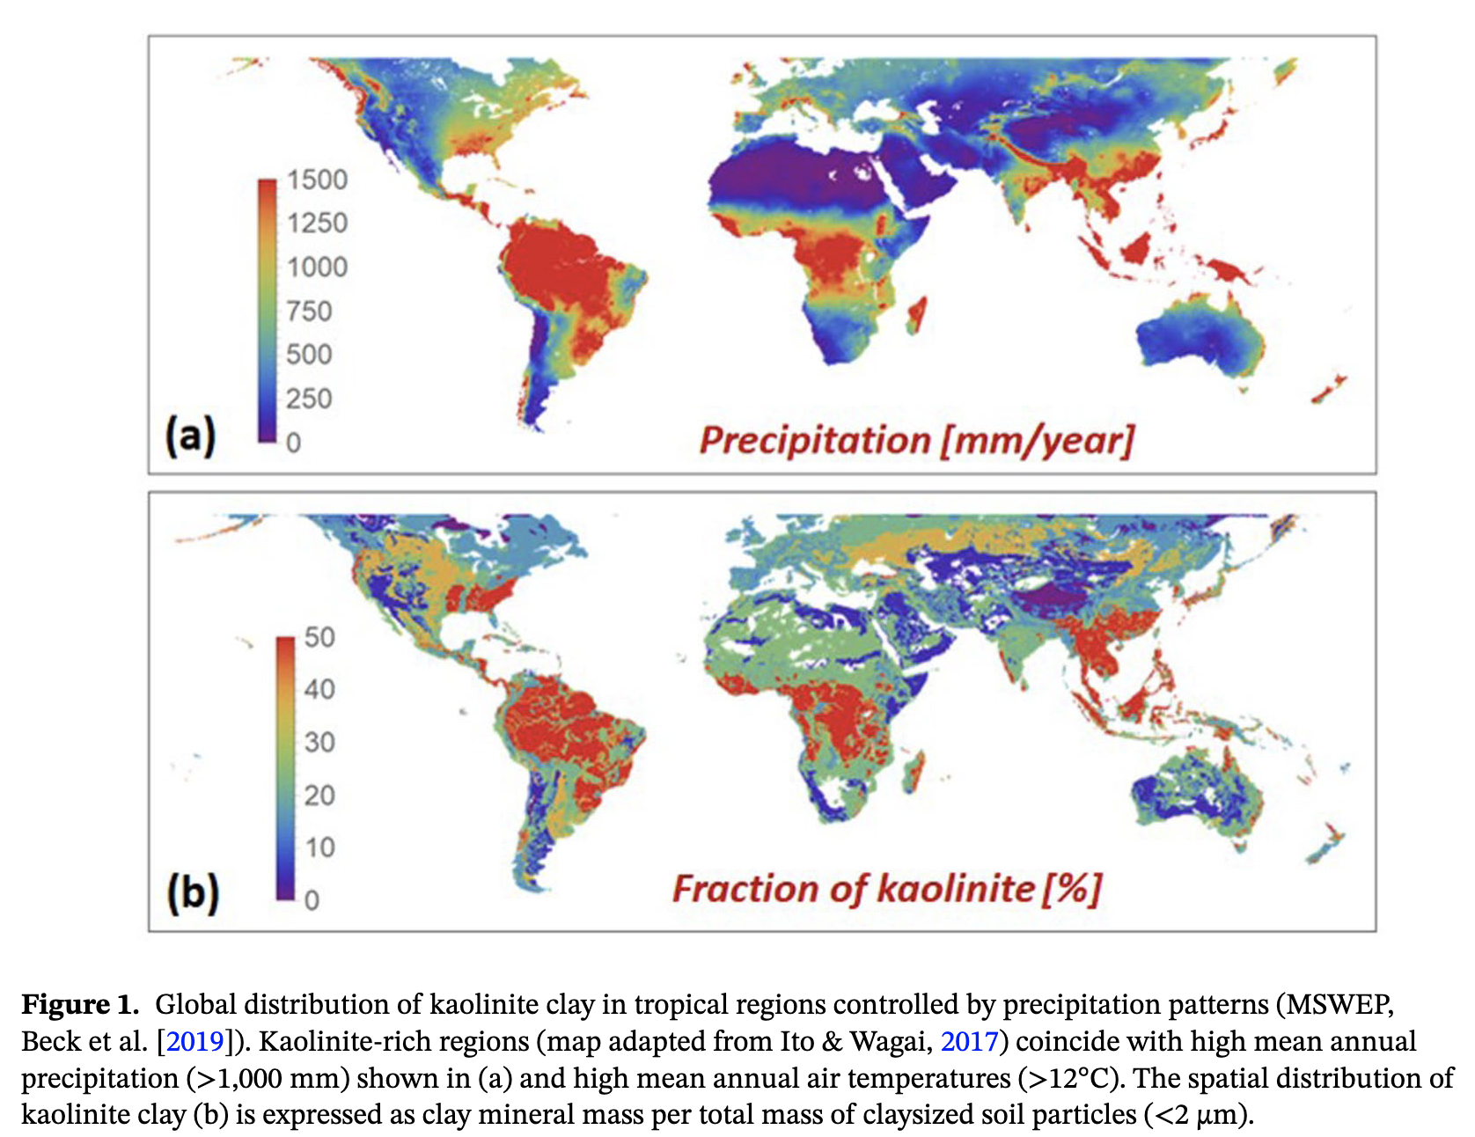
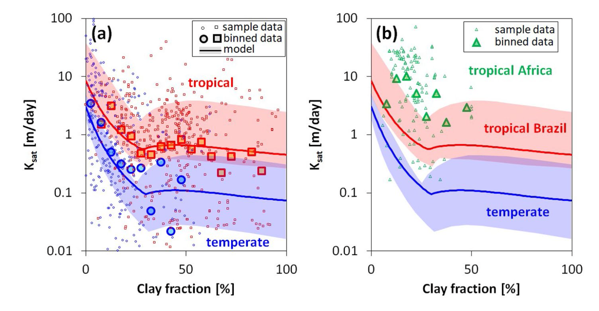
Examples of outstanding issues
Clay type
Lehmann, P., Leshchinsky, B., Gupta, S., Mirus, B. B., Bickel, S., Lu, N., & Or, D. (2021). Clays are not created equal: How clay mineral type affects soil parameterization. Geophysical Research Letters, 48, e2021GL095311. https://doi. org/10.1029/2021GL095311
LSM summit, Oxford, 12-15 September 2022
Notes:
Presently, the soil clay content is used to parameterize soil hydraulic and mechanical properties (SHMP) for land surface models while disregarding the type of clay mineral. This undifferentiated use of clay leads to inconsistent parameterization, particularly between tropical and temperate soils
kaolinite and smectite as end members of the clay mineral family due to their contrasting surface areas, differences in activity (shrink-swell behavior), high abundance in natural soils, and their general separation among climatic regions (e.g., kaolinite dominates in tropical soils that receive high values of mean annual precipitation
Hodnett and Tomasella (2002) showed that two important soil hydraulic parameters, the water retention parameter alpha [L−1] (alpha is linked to the inverse capillary head for air entry pressure) and the saturated water content are considerably higher in tropical regions for the same clay fraction. A recent review by Luijendijk and Gleeson (2015) also reported higher saturated hydraulic conductivity values Ksat [L T−1] for kaolinite clays relative to smectite.
For example, Du et al. (2016) noted that land surface models underestimate subsurface runoff in the Ama-zon and attributed this difference to neglecting aggregates and macropores.

Slide 13
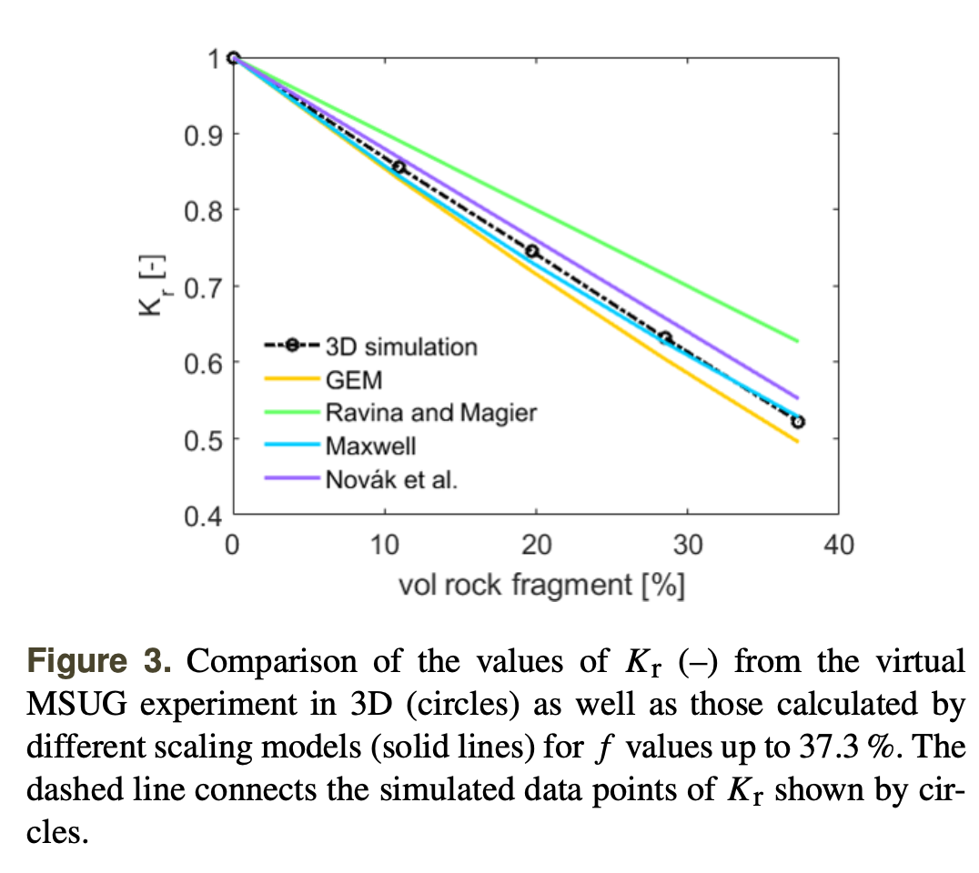
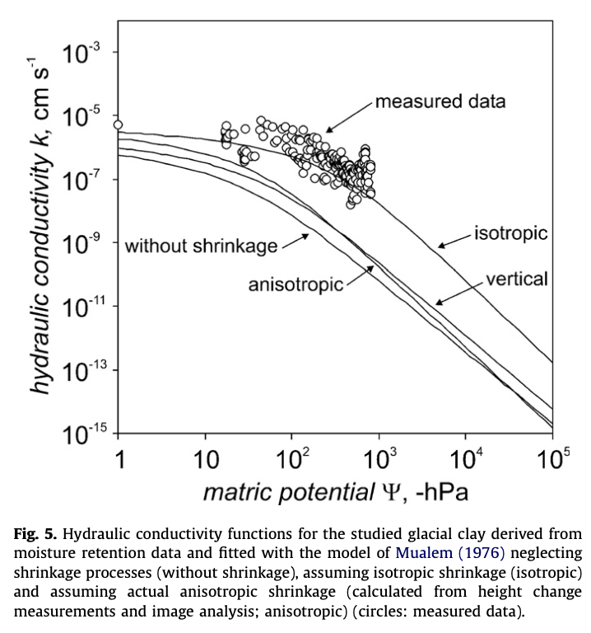
Examples of outstanding issues
Effect of rock fraction
Shrinking and swelling soils
Gebhard et al., 2012,
Soil & Tillage Research
125 (2012) 96–104
Naseri, M., Iden, S. C., and Durner, W.: Effective hydraulic properties of 3D virtual stony soils identified by inverse modeling, SOIL, 8, 99–112, https://doi.org/10.5194/soil-8-99-2022, 2022
LSM summit, Oxford, 12-15 September 2022

Slide 14
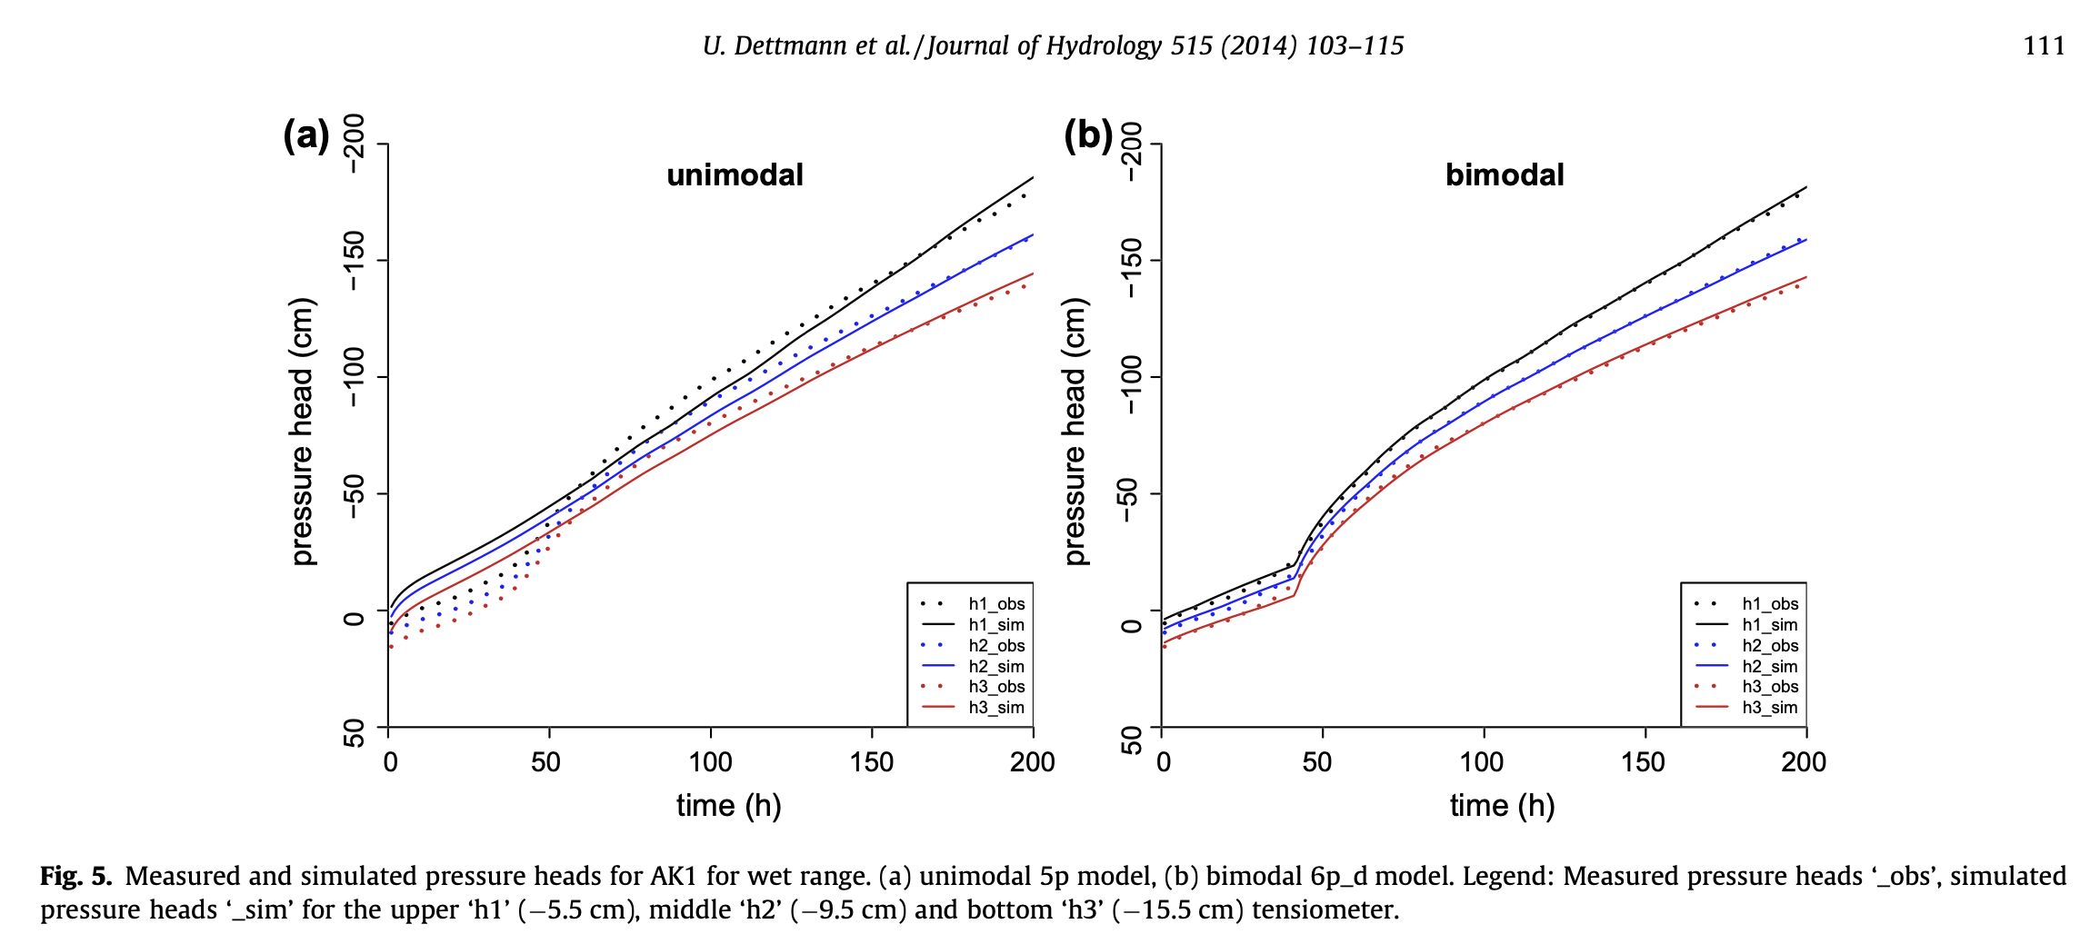
Bimodal soil hydraulic parameters
Bi-or multi-modal soil hydraulic properties
LSM summit, Oxford, 12-15 September 2022
Notes:
certain types of clay, peat soils and e.g. chalk soils have bi-modal WRC and K-curves. WRC with uni-modal fit left and multi-modal fit right.

Slide 15
Conclusions PTFs and covariates
efforts to improve the description of hydraulic properties in models using PTFs.
bi-modal and multi-modal hydraulic functions exist, but they are currently not used in LSMs
Also, reliable PTFs for these hydraulic functions are not yet available.
Ideally, seamless multiscale PTFs should be developed (soil profile → global scale): e.g., multiscale Bayesian neural-network-based PTF (allows upscaling and downscaling of soil hydraulic parameters).
Most models rely on a single set of PTFs to estimate soil hydraulic properties causing statistical bias, underestimation of PTF uncertainty and overconfidence in the predictive ability of PTF: ensemble PTFs that unify multiple sets of PTF are recommended
most of the measurements for PTF parameterization originate from arable land in temperate regions.
Urgent need for PTF development for soils that formed below natural vegetation and taking different regions into consideration
Carbon-rich soils are also poorly represented by PTFs
Conduct detailed field studies in data-scarce regions, such as large parts of tropical and permafrost peatlands
LSM summit, Oxford, 12-15 September 2022

Slide 16
Outlook
We need time-variable interactive soil ‘parameters’: soil structure-related parameter change over long-term (weathering) to seasonal time-scales (tillage, livestock pressures, swell-shrink, freeze-thaw)
A closer cooperation between soil scientists and global land surface modellers is urgently needed: ISMC & GLASS SoilWAt efforts
Soil-data hypercube: the community will need to embrace hypercube-based visualization, which extends traditional space-time cubes into higher dimensions spanned by contemporary soil and environmental information
Cloud computing will also play a central role in the management, extraction and direct simulation of spatial data (Google Earth Engine).
Need for unifying theoretical soil physical approaches, which requires fully coupling soil hydraulic, thermal and gas flow properties
LSM summit, Oxford, 12-15 September 2022
Notes:
Role of compound extremes on soils..
Link to above-ground land management modelling (conservation agriculture)
Critical point is fluid???
Km scale is key to structure changes etc. (e.g., changes in soil structure via root-growth, root-exudation or bio-urbation affecting soil hydraulic properties):
physical
tillage,
traffic compaction, livestock pressures
swell/shrink and
freeze/thaw
Bio-chemical
plant root growth, root exudates
soil microbial and faunal activity

Slide 17
Questions?
a.verhoef@reading.ac.uk
LSM summit, Oxford, 12-15 September 2022
Notes:
Role of compound extremes on soils..
Link to above-ground land management modelling (conservation agriculture)
Critical point is fluid???
Km scale is key to structure changes etc. (e.g., changes in soil structure via root-growth, root-exudation or bio-urbation affecting soil hydraulic properties):
physical
tillage,
traffic compaction, livestock pressures
swell/shrink and
freeze/thaw
Bio-chemical
plant root growth, root exudates
soil microbial and faunal activity

Slide 18
Extra Slides
LSM summit, Oxford, 12-15 September 2022
Notes:
Km scale is key to structure changes etc.

Slide 19
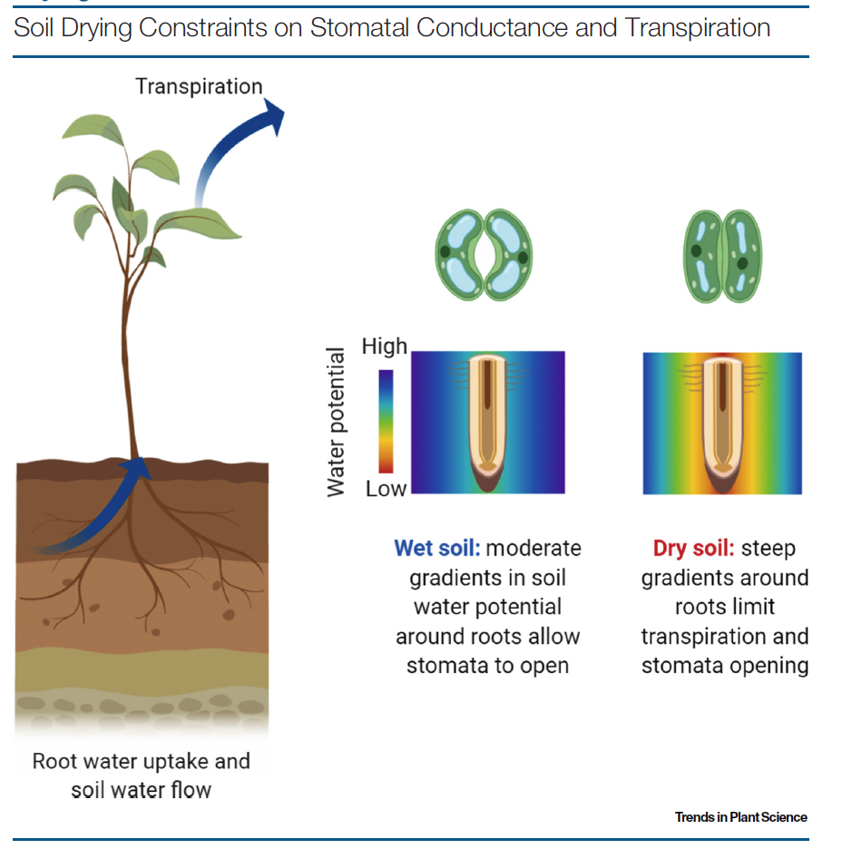
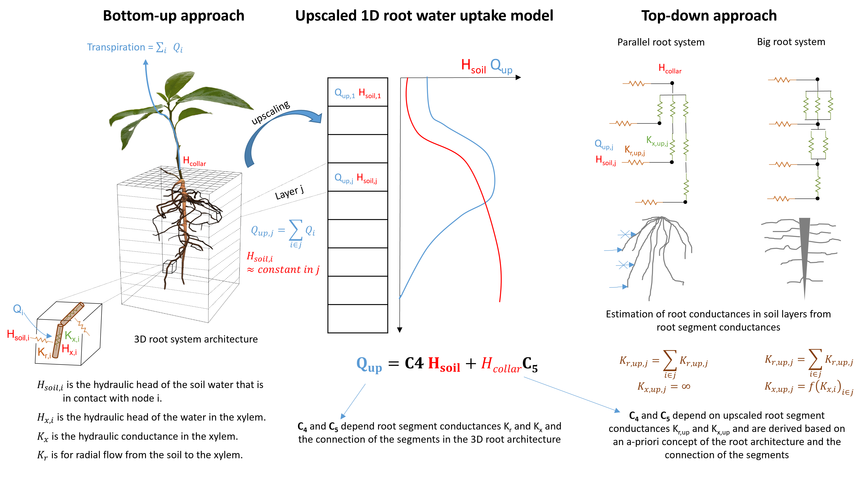
Soil-Root Hydraulics
(Vanderborght, et al. 2021)
(Carminati and Javaux, 2020)
Collaborative Benchmarking of Functional-Structural Root Architecture Models, to evaluate how certain representations of root architecture and model approximations influence simulated root water uptake.
For example, the large water potential gradients around single roots in dry soils have a large impact on simulated water uptake. (Schnepf, et al. 2020, Frontiers in Plant Science)

Slide 20
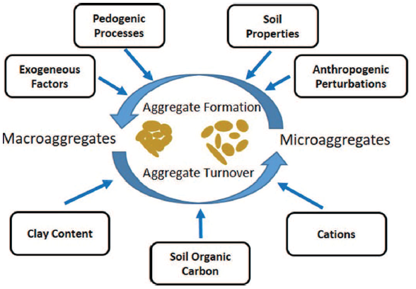
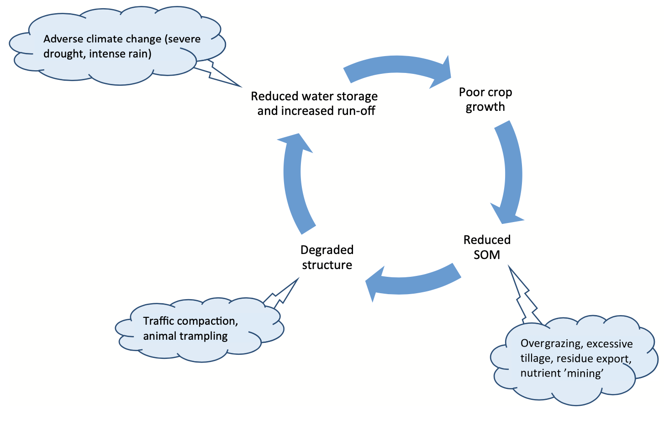
Temporal variation in soil H&T&G parameters
Time-scales: seasonal, decadal, centuries
physical
tillage,
traffic compaction, livestock pressures
swell/shrink and
freeze/thaw
Bio-chemical
plant root growth, root exudates
soil microbial and faunal activity
(Vereecken et al., 2019, VZJ)
Soil aggregation and macropores increase bypass/preferential flow, therefore increasing the hydraulic conductivity and movement of water to deeper soil layers.
Growing vegetation modifies the soil matrix, affecting soil hydraulic conductivity and soil water storage.
Implemented in LSM?
Meurer et al., A framework for modelling soil structure dynamics induced by biological activity, GCB, 2020
LSM summit, Oxford, 12-15 September 2022

Slide 21
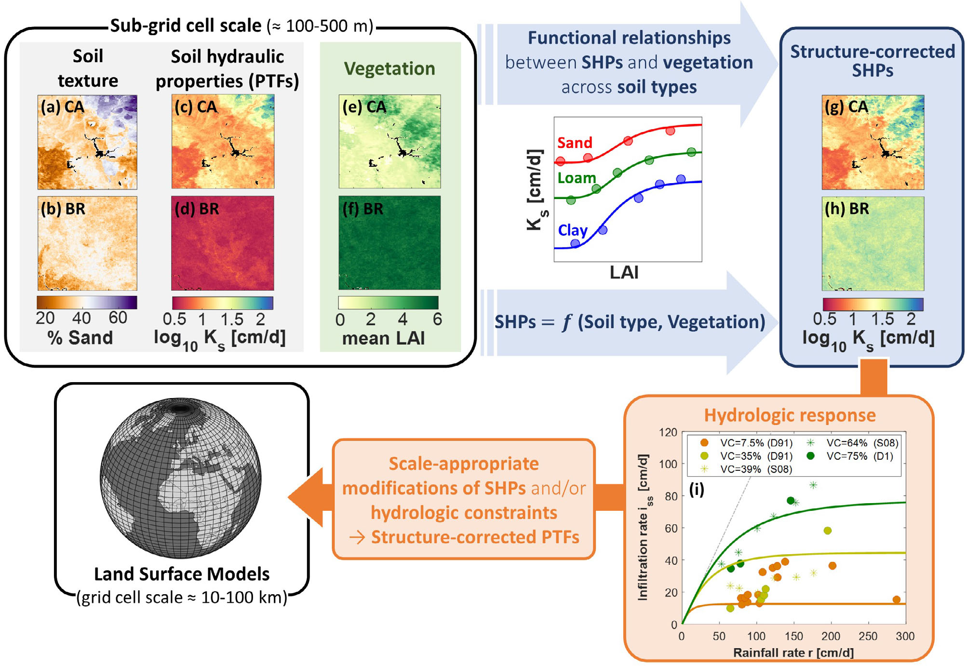
Soil Physical Processes (Infiltration, surface evaporation, water/heat flow)
Proposed methodology for the development of structure-corrected soil hydraulic properties to be used in Land Surface Models:
Establishing functional relationships between soil hydraulic properties and vegetation cover across different soil types and biomes, using vegetation metrics as surrogates.
Such functional relationship can be directly employed to correct SHPs from traditional pedotransfer functions (PTFs).
The effect of soil structure on the hydrological response (in terms of runoff-infiltration partitioning) is then quantified from point to grid cell scale to estimate scale appropriate modifications of SHP, accounting for the effect of spatial heterogeneities on the areal-averaged hydrological response.
(Bonetti et al., 2020, Communications Earth & Environment)

